Slide 1
Diversity and Inclusion in Software Development
Laura Dabbish, Bogdan Vasilescu, Sophie Huilian Qiu
Carnegie Mellon University
OurCS Workshop
October 18th - 20th 2019
Notes:
What are your research questions?
What is your research design?
What kind of impact do you see your work having?
What would help your project to be more impactful? What do you need to successfully complete your research project?

Slide 2
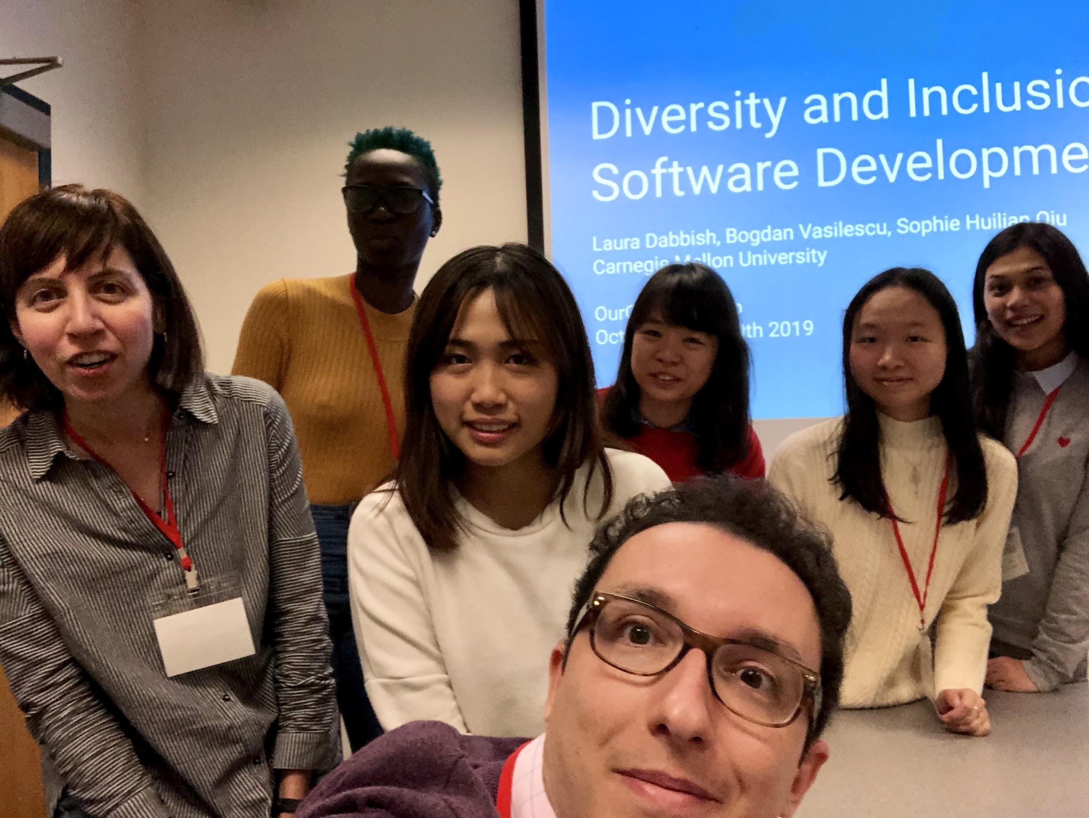
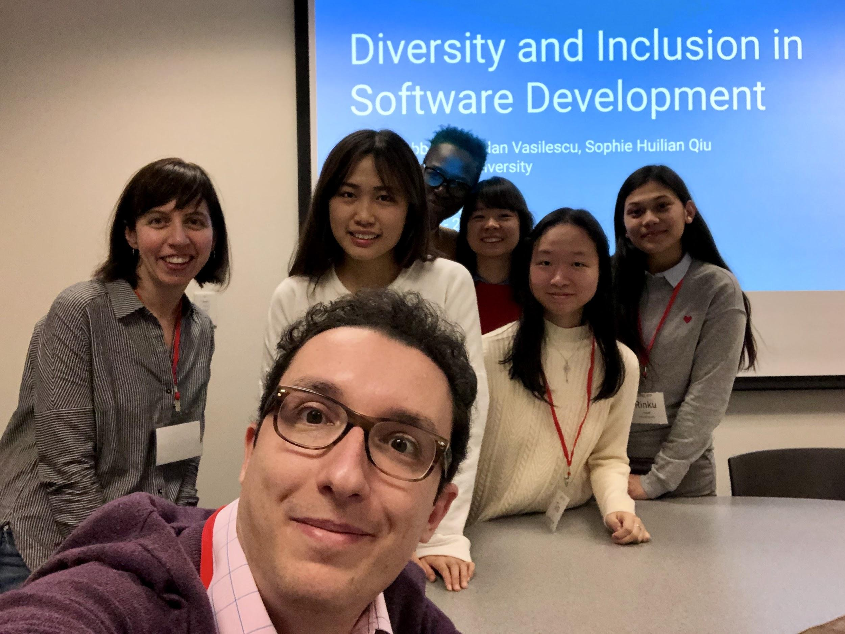
Welcome!

Slide 3
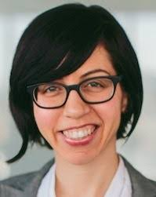
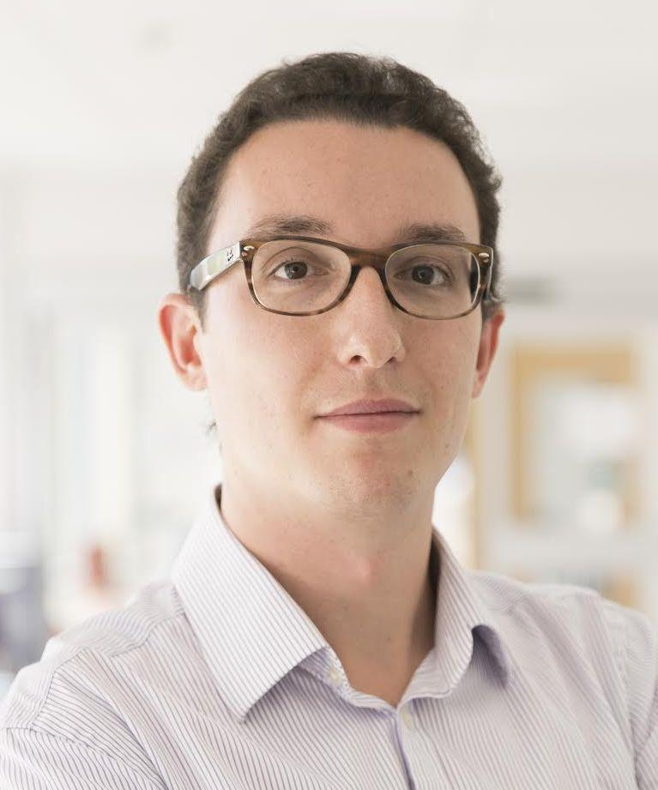
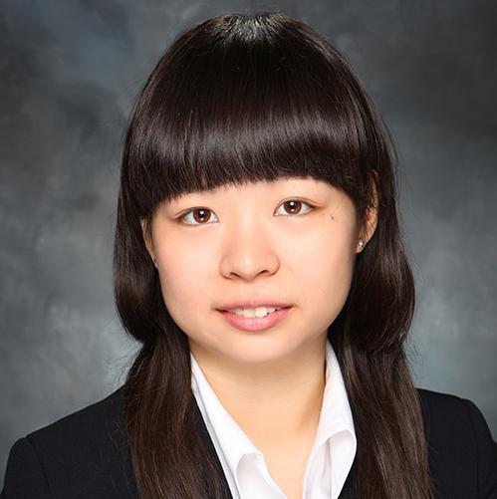
Your team leaders
Studying online social behavior, collaboration in open source, and large scale data analysis
Laura Dabbish
Bogdan Vasilescu
Sophie Huilian Qiu
Associate Professor, HCII & Heinz College, Carnegie Mellon
dabbish@cmu.edu
Asst. Professor, Institute for Software Research, Carnegie Mellon
http://cmustrudel.github.io/
vasilescu@cmu.edu
PhD Student, Institute for Software Research, Carnegie Mellon
huilianq@andrew.cmu.edu
Notes:
Expertise in online social behavior, collaboration in open source, and large scale data analysis

Slide 4

Women are underrepresented in tech.
Open source is no exception.
Notes:
At the same time there is extensive evidence for value in diversity, showing gender and racial diversity are associated with greater creativity and performance in teams, greater earnings (sales, revenue, profit) in organizations, and higher productivity in open-source projects. Enhancing diversity of open-source software projects should enhance their performance as well, improving their efficiency and the reliability and innovativeness of the code they produce.
~30% of employees at large tech firms (2016) 18% of computer science degree grantees in the US (2015) <6% of contributors with 10+ commits to public projects on GitHub
http://superuser.openstack.org/wp-content/uploads/2017/07/OpenStack-Gender-Diversity-Report_Apr2017.pdf

Slide 5
23% of US programmers are women (BLS, 2017)
5% of contributors to public repos on GitHub (OSS survey, Bitergia analysis)
Notes:
At the same time there is extensive evidence for value in diversity, showing gender and racial diversity are associated with
greater creativity and performance in teams
greater earnings (sales, revenue, profit) in organizations,
higher productivity in open-source projects.
Enhancing diversity of open-source software projects should enhance their performance as well, improving their efficiency and the reliability and innovativeness of the code they produce.
~30% of employees at large tech firms (2016) (18-20% in technical roles) 23% of programmers are female (BLS) 18% of computer science degree grantees in the US (2015) <6% of contributors with 10+ commits to public projects on GitHub

Slide 6

Research questions we are addressing in our work
How do women become integrated into digital infrastructure projects?
How are social network structures associated with participation?
Notes:
Although there is some research on barriers to contribution for women and the potential for bias….
It is relatively unknown how underrepresented newcomers, particularly women, become integrated as full members into open-source communities, and why this happens so rarely.
Our recent work suggests that certain social network structures in open-source are crucial for success. So we are interested in understanding how social network structures influence participation.
Men more embedded with higher number of connections meaning more access to information and resources Women more peripheral with less direct ties meaning less visibility and access to information

Slide 7
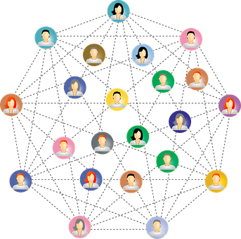
Our research: Mixed methods approach
0. Identify digital infrastructure projects
Social network analysis
Associate network position with participation trajectories
Interviews and observation
Understand contribution experience for males vs females in different network positions
https://www.photos.sh
Notes:
In this research we are taking a mixed methods approach combining large scale social network analysis with smaller scale interviews and observations
In our first step we are Identifying critical digital infrastructure projects using the network of project dependencies.
We plan to focus on a subset of the top 10-20 most critical infrastructure projects, and utilize social network and activity log data from GitHub to model how network position is associated with different contribution and participation trajectories and outcomes.
We will collect first person accounts of the contribution experience from male and female participants at different levels of membership and observe their interaction behaviors on the publicly available portions of GitHub. Interviews will discuss how they became involved with open source, their contribution experiences, and motivations for participation. This will result in a dataset of interview transcripts and behavior logs for contributors at each membership level across project sizes.
We will utilize social network and activity log data from GitHub to model how network position is associated with different contribution and participation trajectories and outcomes.
To support this activity we will begin by extending existing GitHub gender classifier and social network mining software. We will validate gender classification from our GitHub gender classifier, using random sampling and hand coding. We will generate ego networks of men and women with different contribution levels in our sample. This network will be based on shared contributions where two people are linked in the network if they contributed to the same project. We will analyze our mined social network data to examine how network position in one time period is associated with contribution behavior levels in a later time period.
We will collect first person accounts of the contribution experience from female participants at different levels of membership and observe their interaction behaviors on the publicly available portions of GitHub. Interviews will discuss how they became involved with open source, their contribution experiences, and motivations for participation. This will result in a dataset of interview transcripts and behavior logs for contributors at each membership level across project sizes.
Next we will collect survey response data about the participation experience from both male and female contributors at different levels of project membership across projects of different sizes. The survey will allow us to quantify the findings from our interview study with a broader sample and contrast male and female participation experiences.
Finally we utilize social network and activity log data from GitHub. This will require generating ego networks of women on GitHub, who we will identify through an analysis of names (which we have done successfully in the past). We have a local copy of GitHub data, and have used it to construct networks of projects and people, and have explored and compared social networks of men and women participants. We will update it and supplement as needed.

Slide 8
Practical Impact
Develop guidelines for sponsors and mentors to better integrate women into their projects.
Notes:
Our research has the potential majorly enhance workforce development. Participation in open source software is increasingly important for obtaining employment in technical fields.
This means we could potentially
Increase employment options for women
Double available tech workforce
Enhance HR for sustaining digital infrastructures
Participation in open source software is increasingly important for obtaining employment in technical fields.
Finding ways to make open source communities more welcoming to women could potentially nearly double the available workforce, with major benefits both to industry, where technical talent is in short supply, and to society by
greatly enhancing our ability to provide human resources necessary for sustaining our digital infrastructure.
---
https://opensourcediversity.org/
https://github.com/chaoss/wg-diversity-inclusion

Slide 9
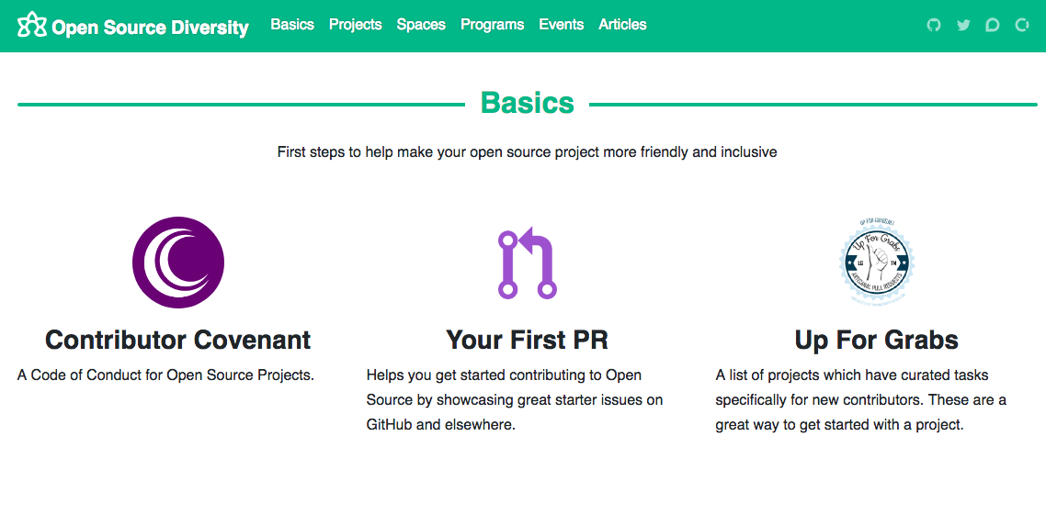
https://opensourcediversity.org/#basics

Slide 10
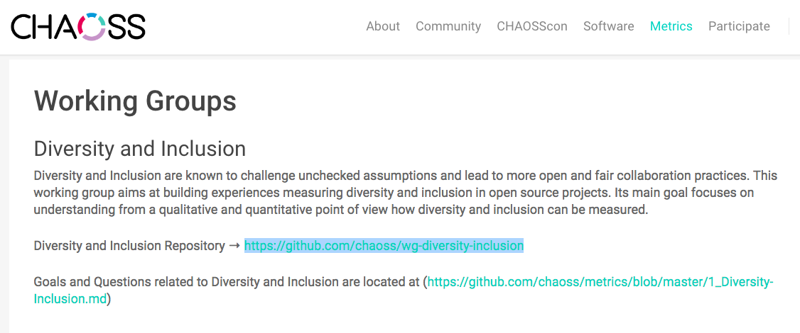
https://chaoss.community/metrics/

Slide 11

Weekend goal
Analyze set of OSS projects to look at what associates with gender diversity...
David Dicello

Slide 12
Our weekend research question
How do OSS project characteristics associate with gender diversity?
Notes:
Although there is some research on barriers to contribution for women and the potential for bias….
It is relatively unknown how underrepresented newcomers, particularly women, become integrated as full members into open-source communities, and why this happens so rarely.
Our recent work suggests that certain social network structures in open-source are crucial for success. So we are interested in understanding how social network structures influence participation.
Men more embedded with higher number of connections meaning more access to information and resources Women more peripheral with less direct ties meaning less visibility and access to information

Slide 13
OurCS
Weekend Plan
Friday
0: Intro & background
1: Tools & data
2: Compute features
Saturday
3: Combine & analyze
4: Finish analysis
Sunday
5: Prepare presentation
6: Present results
Notes:
Our research has the potential majorly enhance workforce development. Participation in open source software is increasingly important for obtaining employment in technical fields.
This means we could potentially
Increase employment options for women
Double available tech workforce
Enhance HR for sustaining digital infrastructures
Participation in open source software is increasingly important for obtaining employment in technical fields.
Finding ways to make open source communities more welcoming to women could potentially nearly double the available workforce, with major benefits both to industry, where technical talent is in short supply, and to society by
greatly enhancing our ability to provide human resources necessary for sustaining our digital infrastructure.
---
https://opensourcediversity.org/
https://github.com/chaoss/wg-diversity-inclusion

Slide 14
Logistics and process
Each session you’ll have different partners
Share out at the end of each session
Ask questions & help each other :)
Notes:
Our research has the potential majorly enhance workforce development. Participation in open source software is increasingly important for obtaining employment in technical fields.
This means we could potentially
Increase employment options for women
Double available tech workforce
Enhance HR for sustaining digital infrastructures
Participation in open source software is increasingly important for obtaining employment in technical fields.
Finding ways to make open source communities more welcoming to women could potentially nearly double the available workforce, with major benefits both to industry, where technical talent is in short supply, and to society by
greatly enhancing our ability to provide human resources necessary for sustaining our digital infrastructure.
---
https://opensourcediversity.org/
https://github.com/chaoss/wg-diversity-inclusion

Slide 15

Team intros
Name, school & year
How you got into CS
Positive encouraging experience
OSS perceptions
David Dicello

Slide 16
Friday morning
Session 0
Background: OSS and GitHub
Notes:
At the same time there is extensive evidence for value in diversity, showing gender and racial diversity are associated with greater creativity and performance in teams, greater earnings (sales, revenue, profit) in organizations, and higher productivity in open-source projects. Enhancing diversity of open-source software projects should enhance their performance as well, improving their efficiency and the reliability and innovativeness of the code they produce.
~30% of employees at large tech firms (2016) 18% of computer science degree grantees in the US (2015) <6% of contributors with 10+ commits to public projects on GitHub
http://superuser.openstack.org/wp-content/uploads/2017/07/OpenStack-Gender-Diversity-Report_Apr2017.pdf

Slide 17
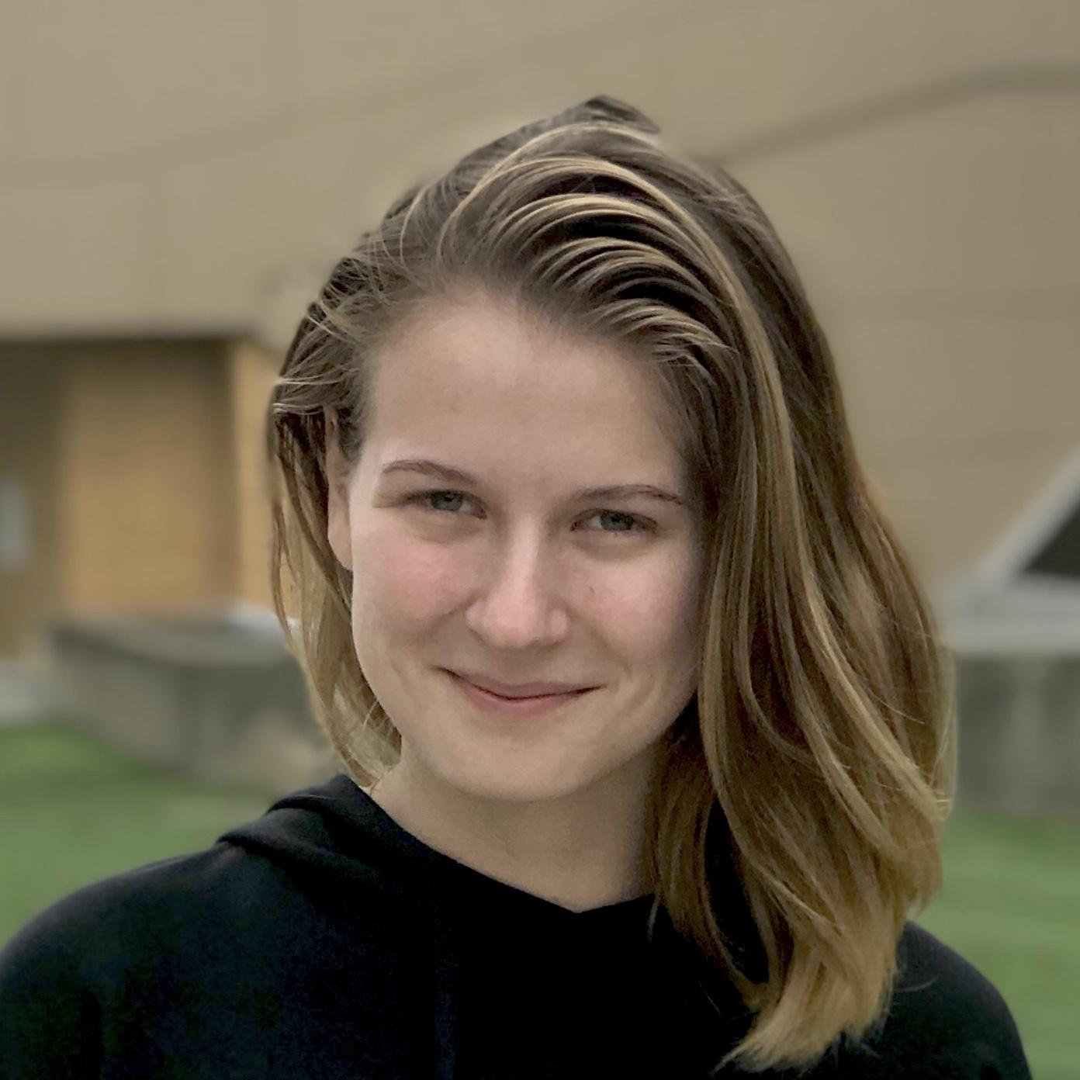
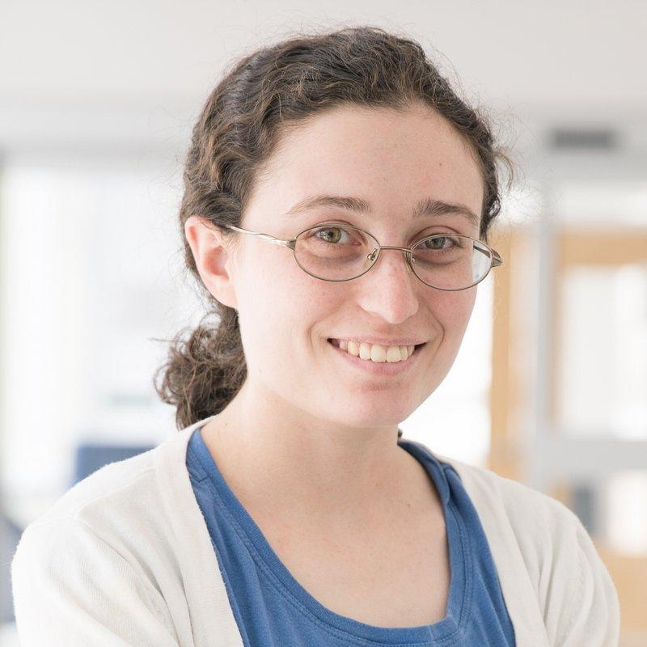

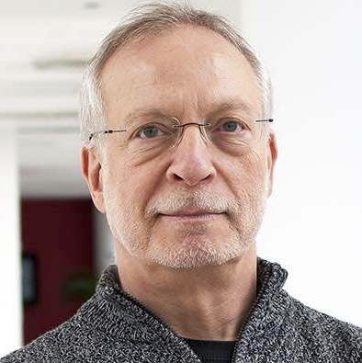
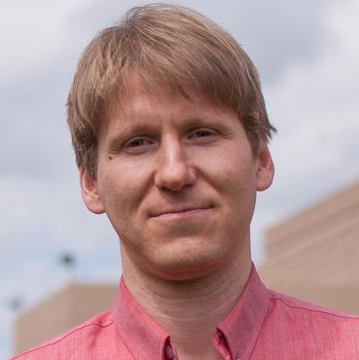
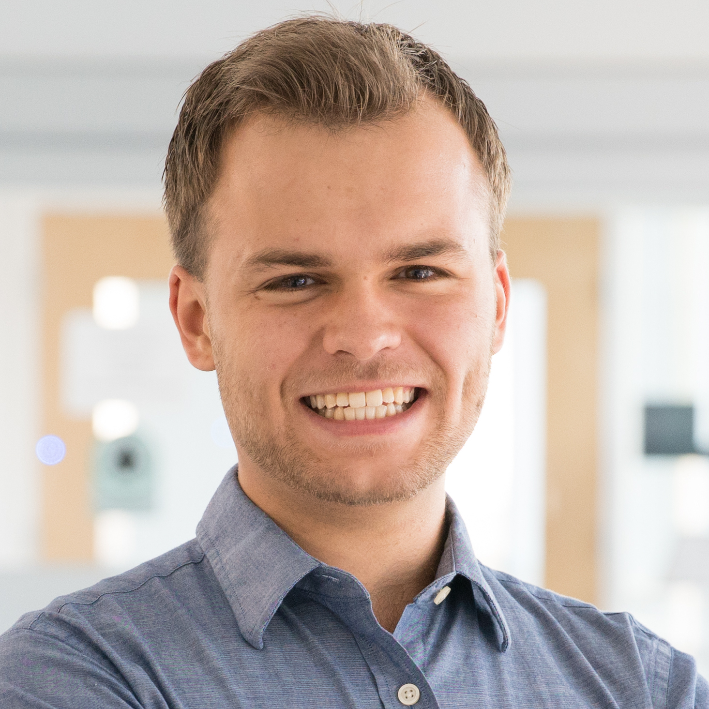
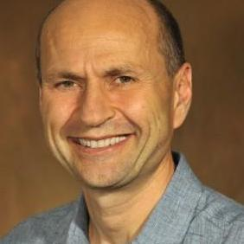
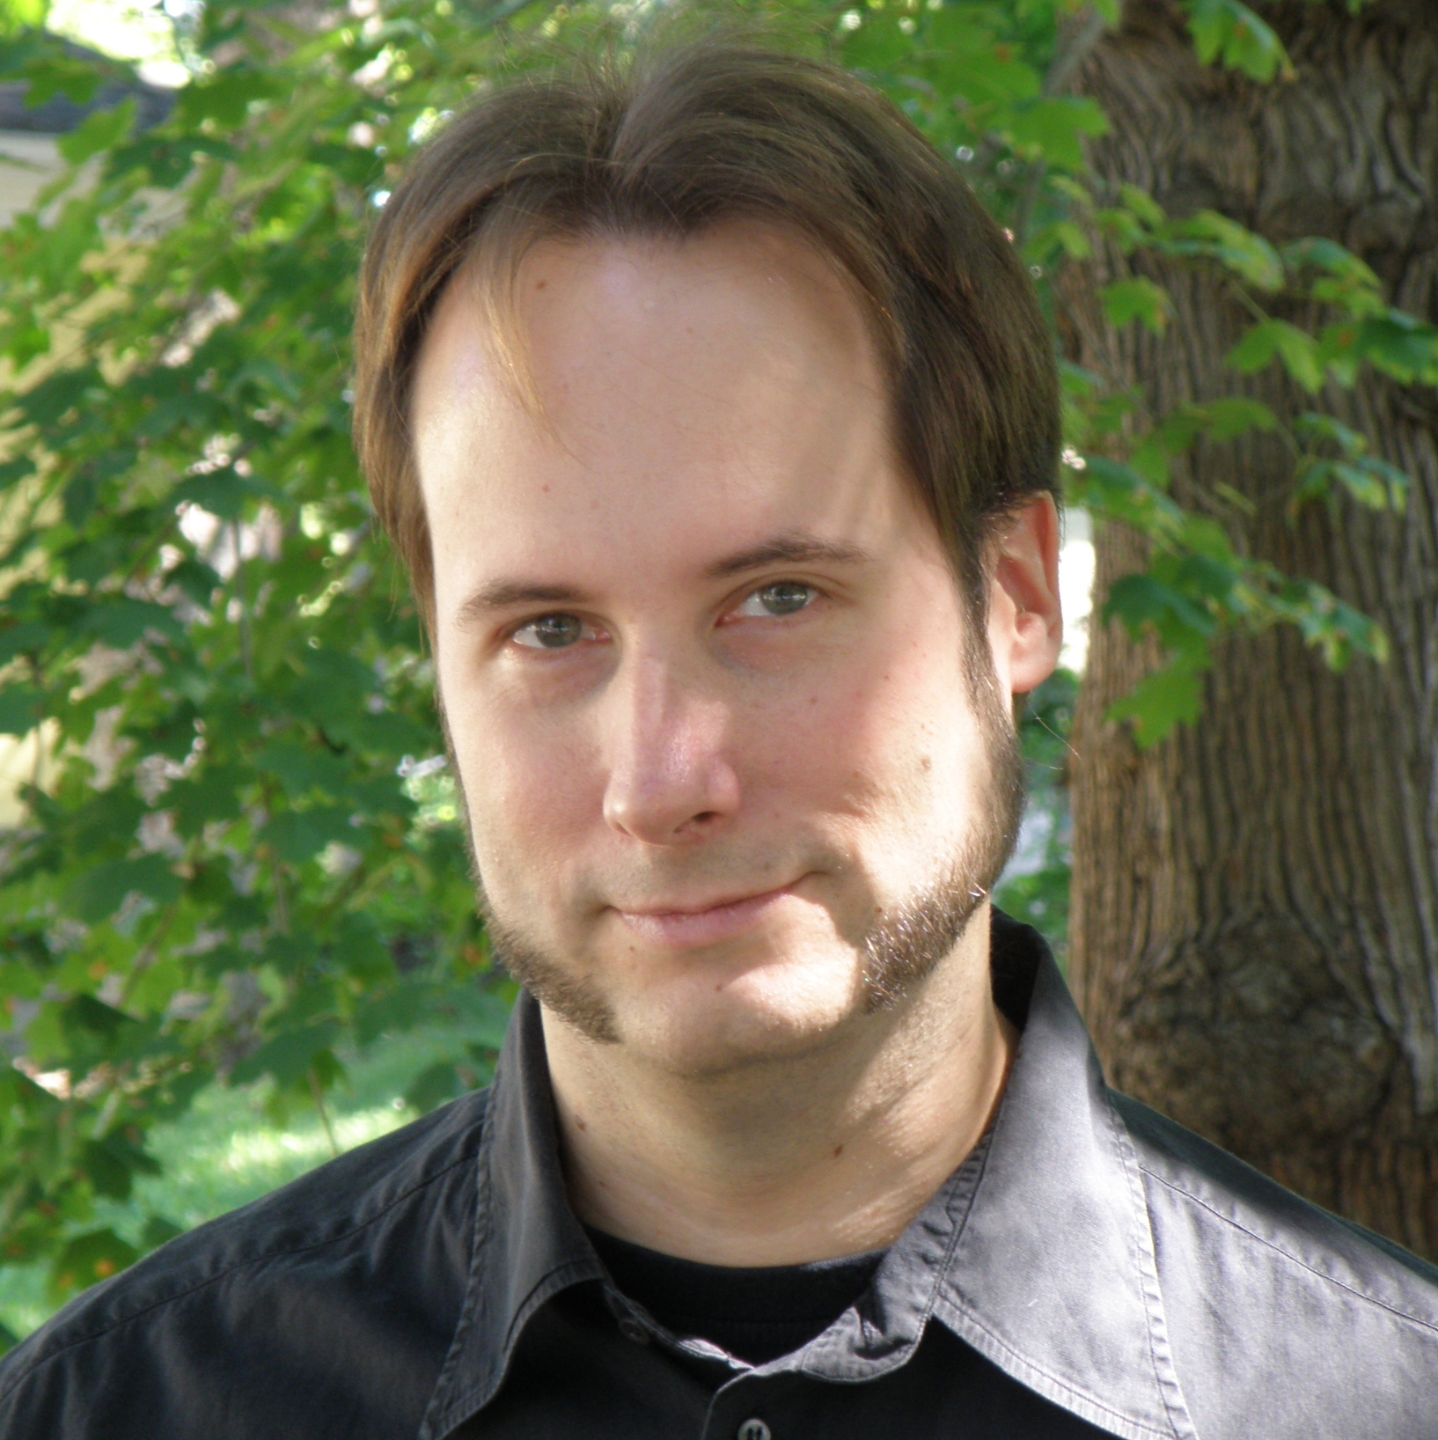
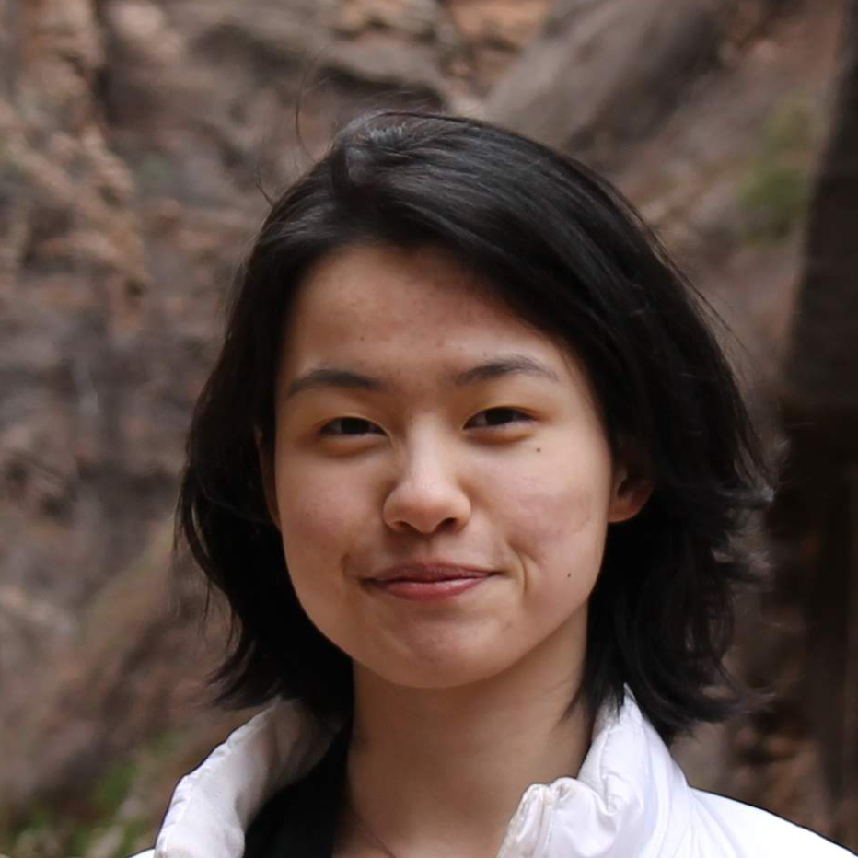
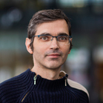
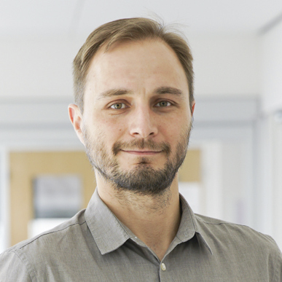
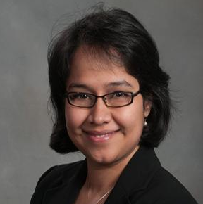
Collaborators
Courtney Miller
Anita Brown
Michelle Cao
Jim Herbsleb
Christian Kästner
David Widder
Audris Mockus
Alex Nolte
Lily Li
Alex Serebrenik
Marat Valiev
Anita Sarma

Slide 18
Why should we care about open source software?

Slide 19


Open source software:
from curiosity to digital infrastructure
1999
2016
Open source code as digital roads or bridges:
can be used by anyone to build software
Nearly all software that powers our society relies on open source code
Everybody uses open source code:
Fortune 500 companies
government
major software companies
startups

Slide 20
Economists: open source as “digital dark matter”
I.e., important but mostly invisible
Apache web server installations valued at $7—$10 billion in the US alone
The economic value of open source software to Europe totaled ~456 billion Euros per year in 2010
There are millions of other open source projects besides the Apache web server, many in similarly important roles
(Greenstein and Nagel, 2016)
(Daffara, 2012)

Slide 21
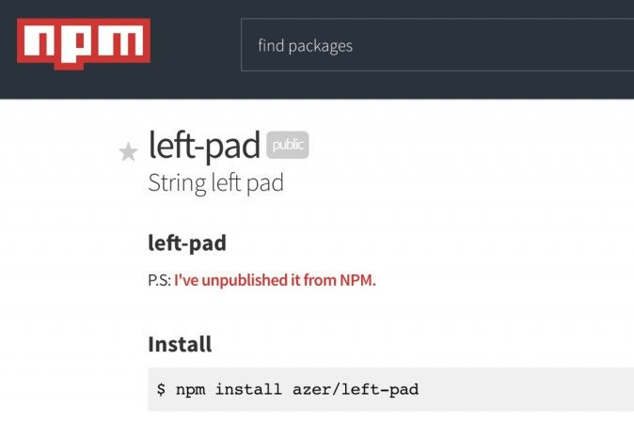


Just like physical infrastructure, digital infrastructure needs regular upkeep and maintenance
Risks for downstream users from depending on abandoned or undermaintained libraries
Security breaches, interruptions in service, …
Leftpad
OpenSSL + Heartbleed
Also slows down innovation
Startups rely heavily on this infrastructure

Slide 22
What does open source look like today?

Slide 23
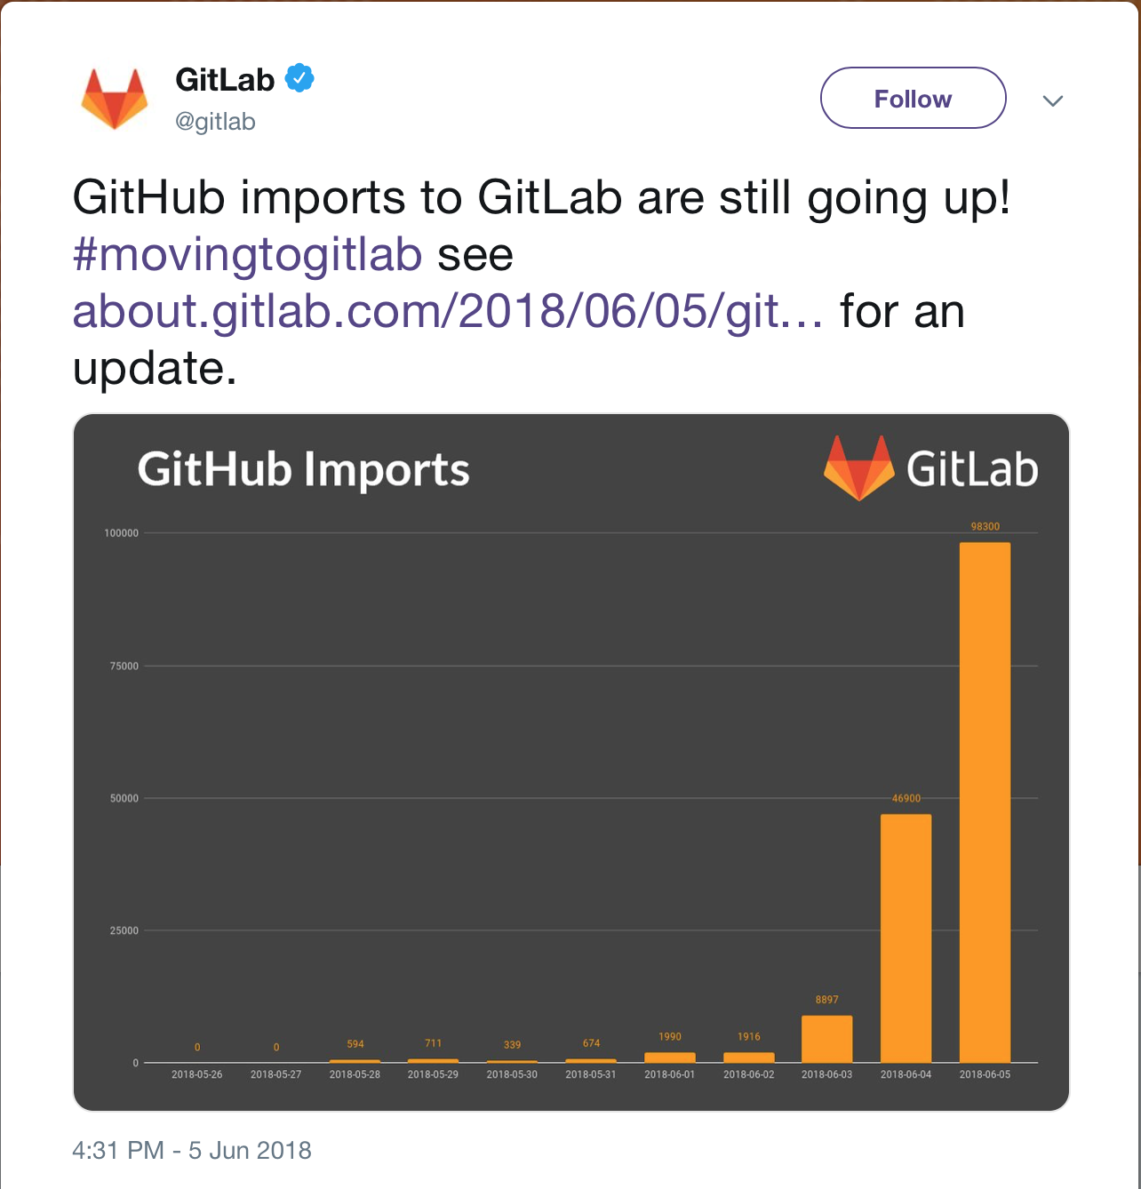



More open source code now than ever before
Explosion of production in the past seven years
6 million users
(March 2019)

Slide 24








Complex ecosystem of interdependencies
Socio-technical environment: heterogeneous links

Slide 25
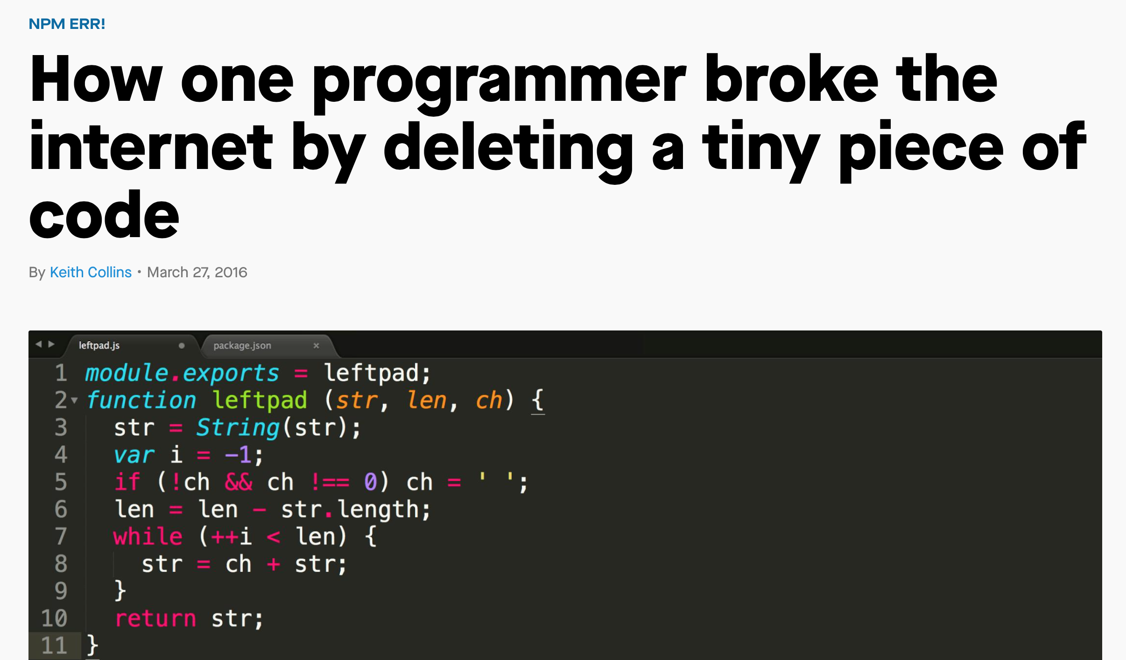
Network effects
Leftpad-like incidents
Breaking changes
(Bogart et al. 2016)
Tangled issue reports
(Ma et al. 2017), (Zhang et al 2018)
…
Within-Ecosystem Issue Linking: A Large-scale Study of Rails. Zhang, Y., Yu, Y., Wang, H., Vasilescu, B., and Filkov, V. Software Mining Workshop 2018

Slide 26









Increasing commercialization and professionalization
Historically
Community-based projects (Python, RubyGems, Twisted)
Currently
Lots of commercial involvement
Companies (Go - Google, React - Facebook, Swift - Apple)
Startups (Docker, npm, Meteor)
23% of respondents to 2017 GitHub survey: job duties include contributing to open source
http://opensourcesurvey.org/2017/

Slide 27
Where does a lot of OSS happen?
GitHub

Slide 28
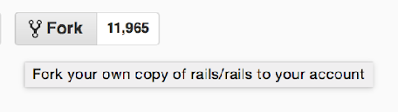

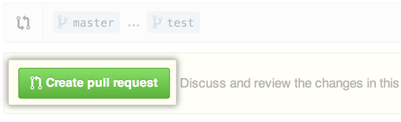
GitHub as a standardized place to collaborate on code
Git version control
GitHub UI
The Pull Request model
Lower barrier to entry
Easier to contribute
More production

Slide 29
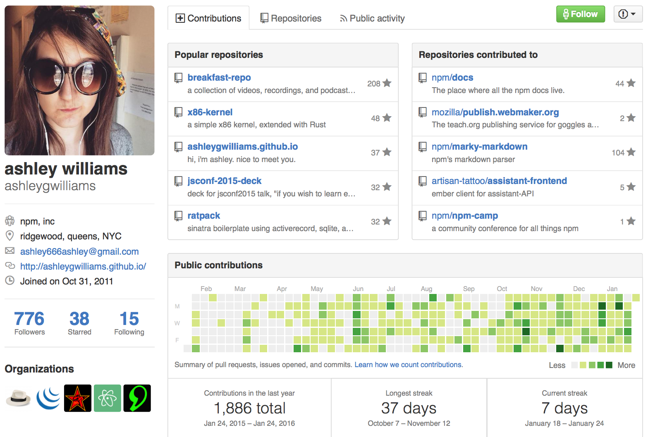

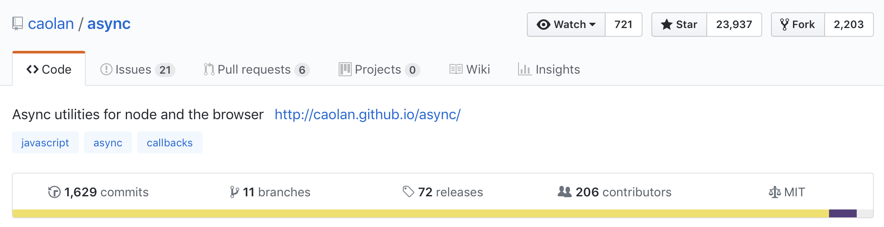
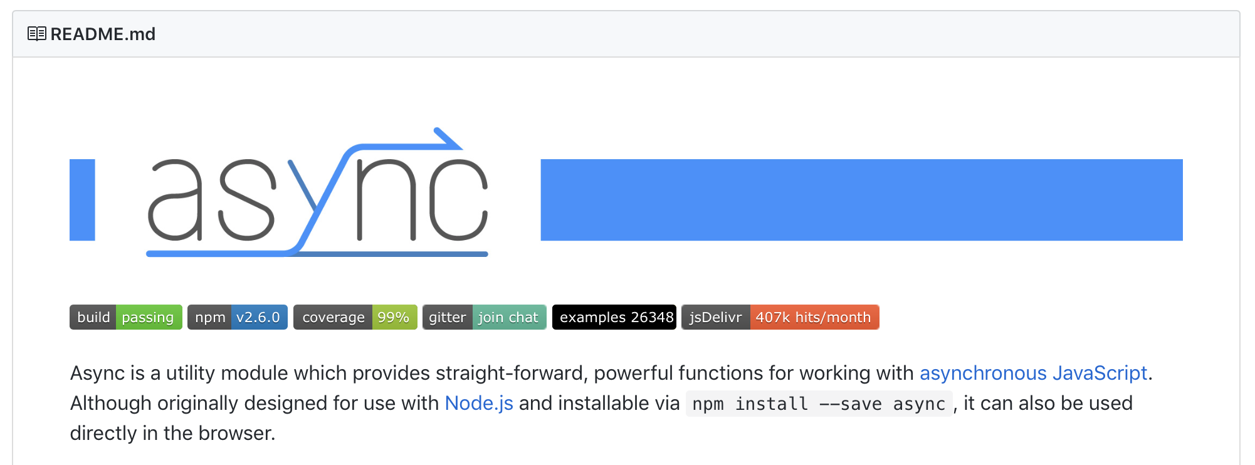
High level of transparency
Profile pages for users and projects
Rich inferences about people’s expertise and level of commitment
Impacts collaboration, but also recruiting and hiring
(Dabbish et al. 2012), (Marlow et al. 2013), (Marlow and Dabbish 2013)
CV

Slide 30
What’s the experience of contributing?

Slide 31
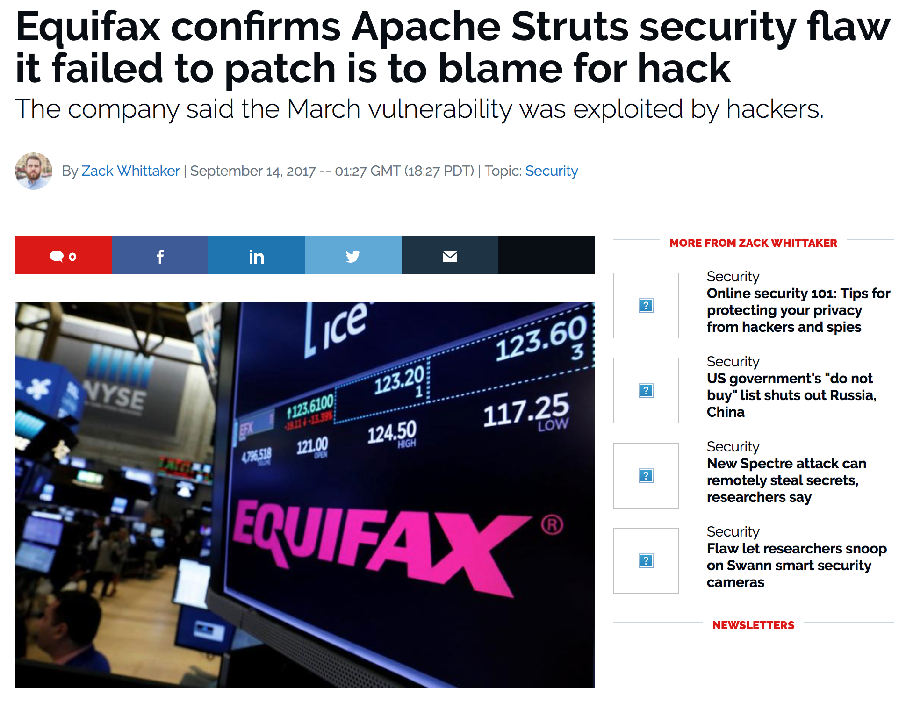
High expectations toward the quality, reliability, and security of open source infrastructure
Equifax (market cap $14 billion) built products on top of open-source infrastructure, including Apache Struts
Equifax did not make any contributions to open source projects
A flaw in Apache Struts contributed to the breach (CVE-2017-5638)
Equifax publicly blamed (with national news coverage) Apache Struts for the breach
https://www.zdnet.com/article/equifax-confirms-apache-struts-flaw-it-failed-to-patch-was-to-blame-for-data-breach/

Slide 32
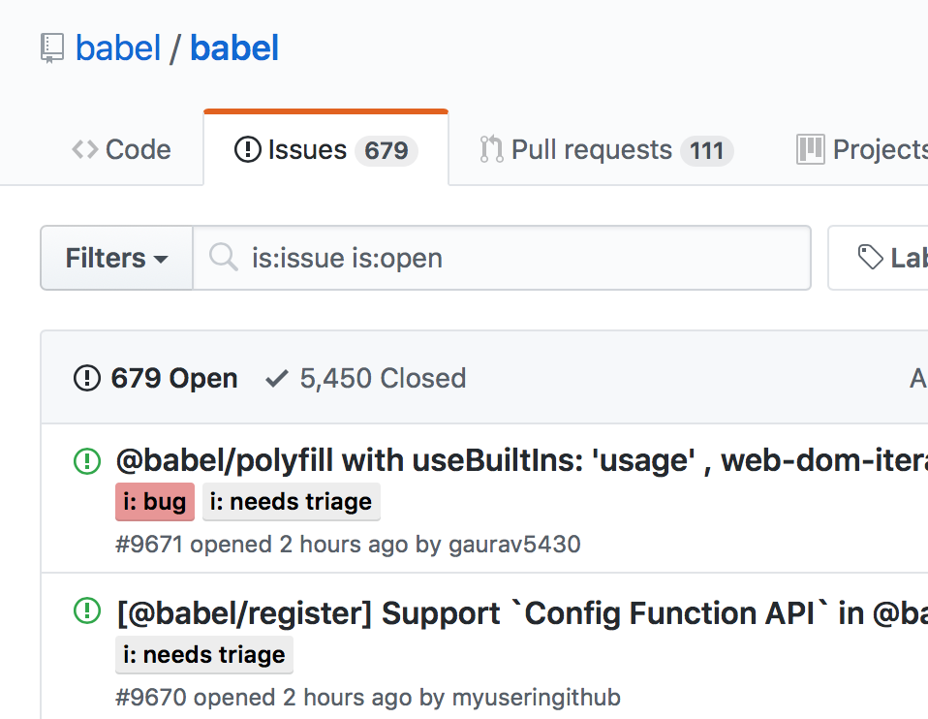
High level of demands & stress
Easy to report issues / submit PRs
Growing volume of requests
Social pressure to respond quickly
Otherwise, off-putting to newcomers (Steinmacher et al. 2015)
Entitlement, unreasonable requests from users:
“I have been waiting 2 years for Angular to track the ‘progress’ event and it still can’t get it right?!?!”
“Thank you for your ever useless explanations.”

Slide 33
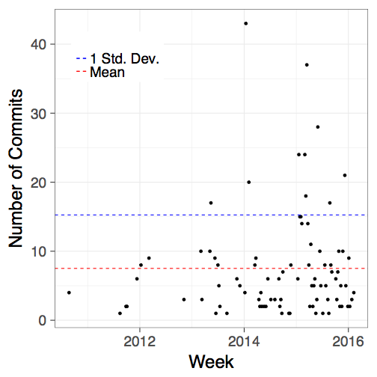
High-workload, potentially high-stress environment
Working on many projects concurrently
Higher than average workload
Mon
Tue
Wed
Thu
Fri
Sat
Sun
#Projects
 | 0 |  | 1 |  | 3 |  | 5 |  | 8
Nov Dec Jan Feb Mar Apr
2013
2014
The Sky is Not the Limit: Multitasking on GitHub Projects. Vasilescu, B., Blincoe, K., Xuan, Q., Casalnuovo, C., Damian, D., Devanbu, P., and Filkov, V. ICSE 2016
Socio-Technical Work-Rate Increase Associates With Changes in Work Patterns in Online Projects. Sarker, F., Vasilescu, B., Blincoe, K., and Filkov, V. ICSE 2019

Slide 34
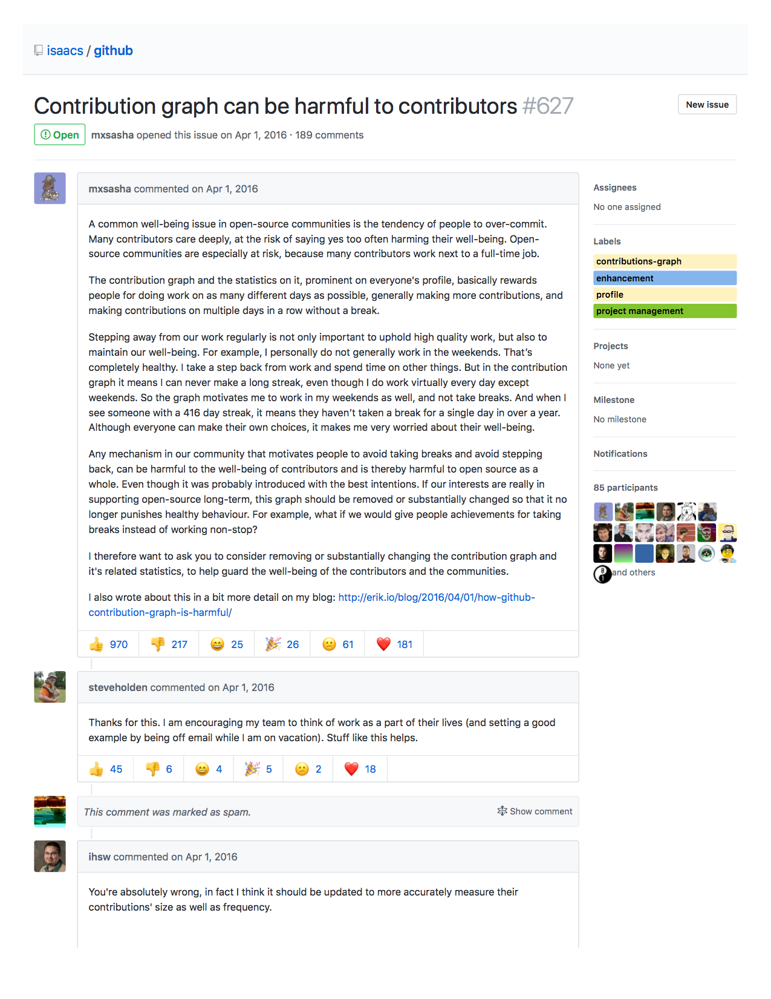
Example: “Longest streak” backlash
…
https://github.com/isaacs/github/issues/627

Slide 35
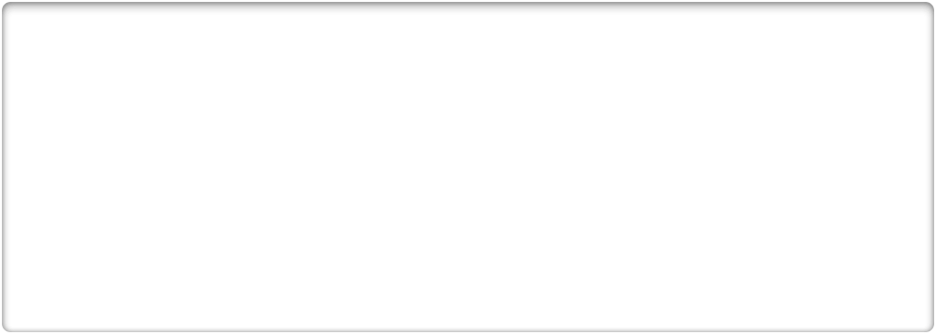


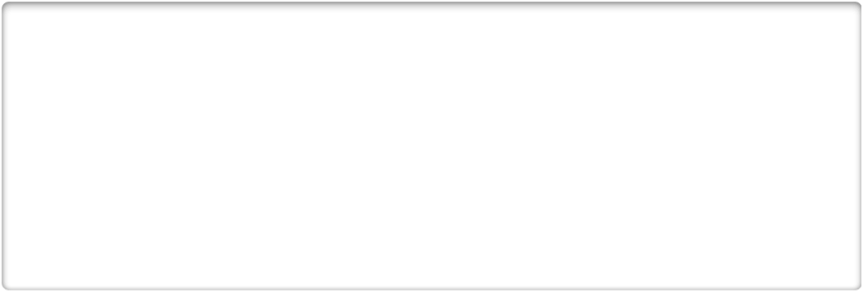



Low demographic diversity
Gender representation reality
Expectation
“More about the contributions to the code than the ‘characteristics’ of the person”
“Any demographic identity is irrelevant”
“Code sees no color or gender”
10.9%
18%
16.6%
Exploring the data on gender and GitHub repo ownership
Alyssa Frazee. http://alyssafrazee.com/gender-and-github-code.html
FLOSS 2013: A survey dataset about free software contributors: challenges for curating, sharing, and combining G Robles, L Arjona-Reina, B Vasilescu, A Serebrenik, JM Gonzalez-Barahona. MSR 2014
Google Diversity (2015) www.google.com/diversity/index.html#chart
Inside Microsoft (2015) https://goo.gl/nT4YiI
Stack Overflow 2015 Developer Survey (26,086 people from 157 countries)
http://stackoverflow.com/research/developer-survey-2015#profile-gender
Perceptions of Diversity on GitHub: A User Survey. Vasilescu, B., Filkov, V., and Serebrenik, A. CHASE 2015

Slide 36
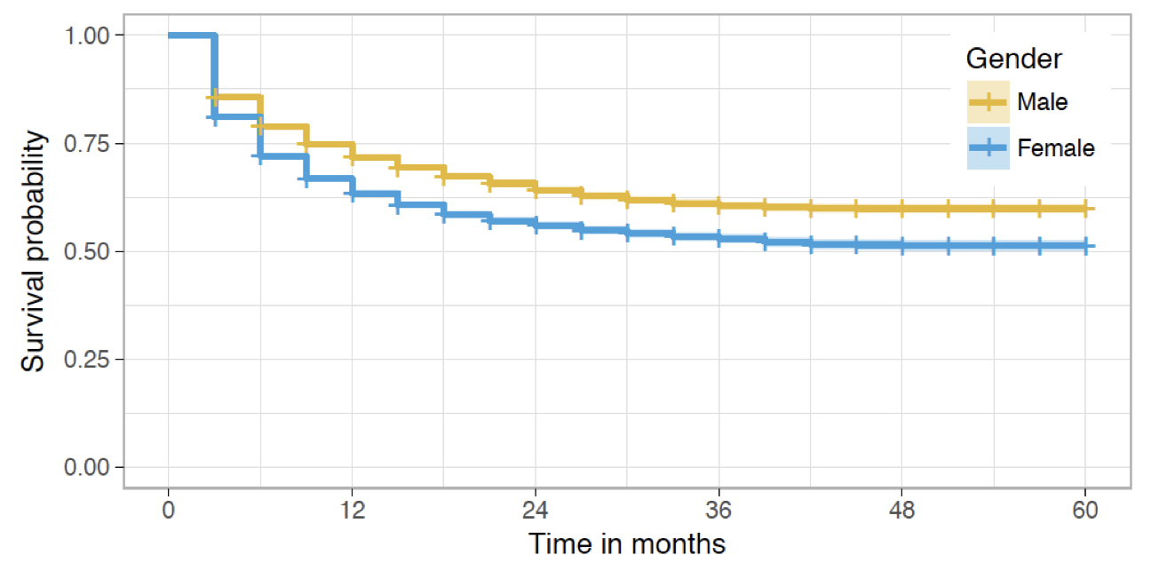
On GitHub, women disengage earlier than men
After one year ~70% of men are still active but only ~60% of women*
*Among committers with first & last names on their profiles
Going Farther Together: The Impact of Social Capital on Sustained Participation in Open Source. Qiu, H.S., Nolte, A., Brown, A., Serebrenik, A., and Vasilescu, B. ICSE 2019
Notes:
On GitHub, women are a minority: less than 10% of all contributors. If we break down the previous survival curve by gender (this was a balanced sample, I’ll talk about how we inferred gender later), we can see that women are dropping out earlier than men. (click) For example, after 12 months, around 70% men are still contributing but only around 60% women.

Slide 37
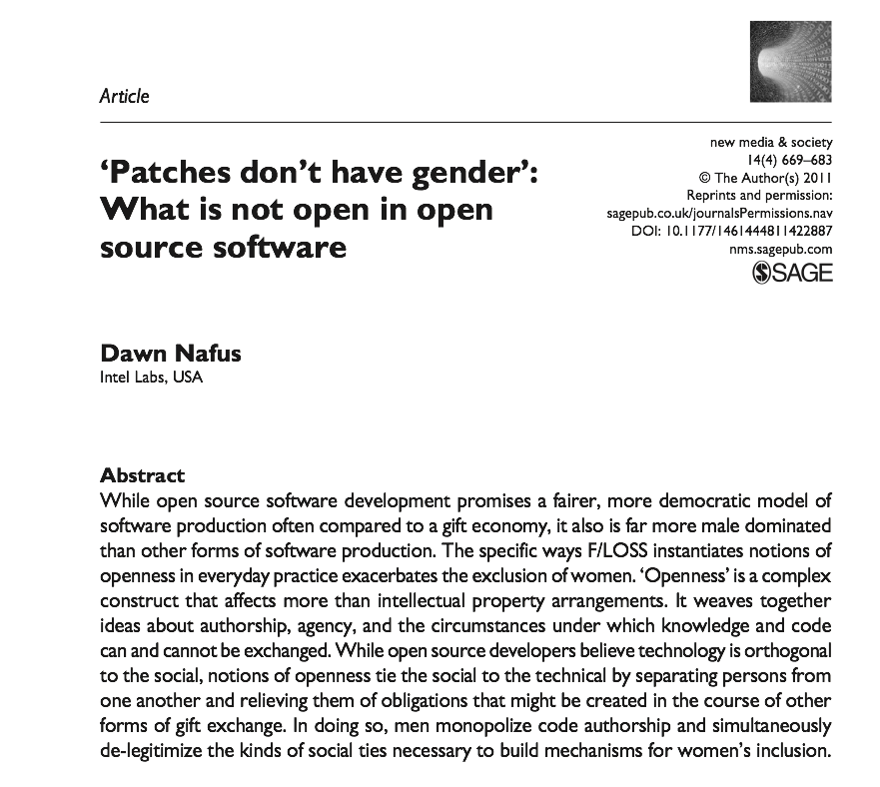
“Sexist behavior in F/LOSS is as constant as it is extreme”

Slide 38
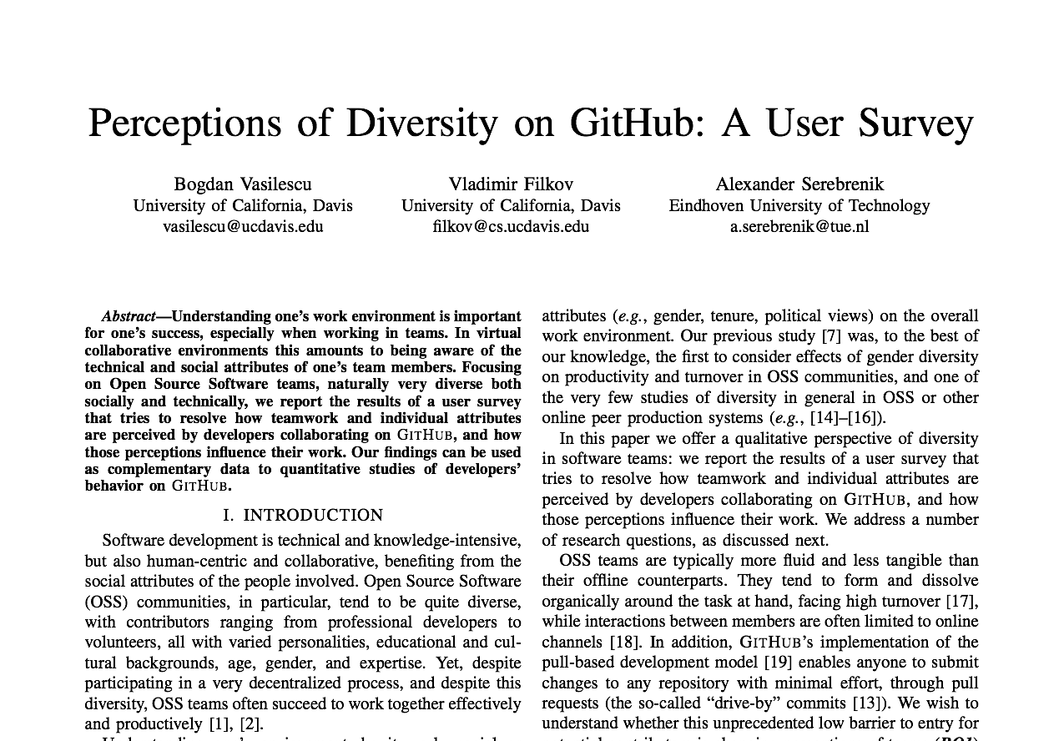
“I have used a fake GitHub handle [...] so that people would assume I was male”

Slide 39
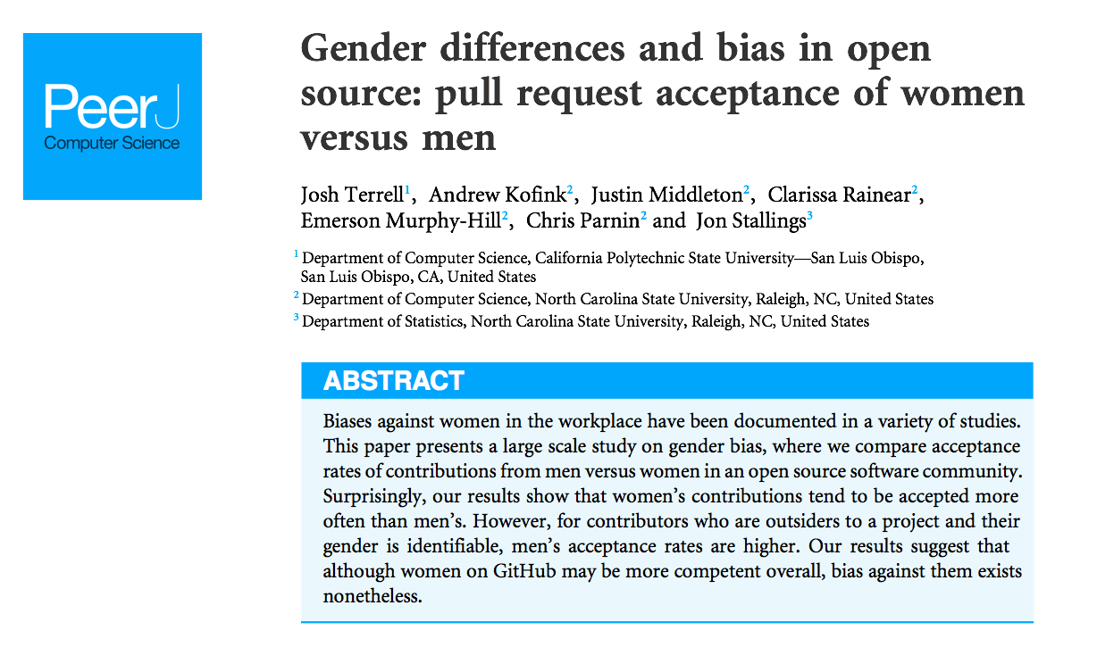
Pull request acceptance rates are lower when gender is apparent

Slide 40
What are people doing to attract & retain (diverse) contributors to open source?

Slide 41
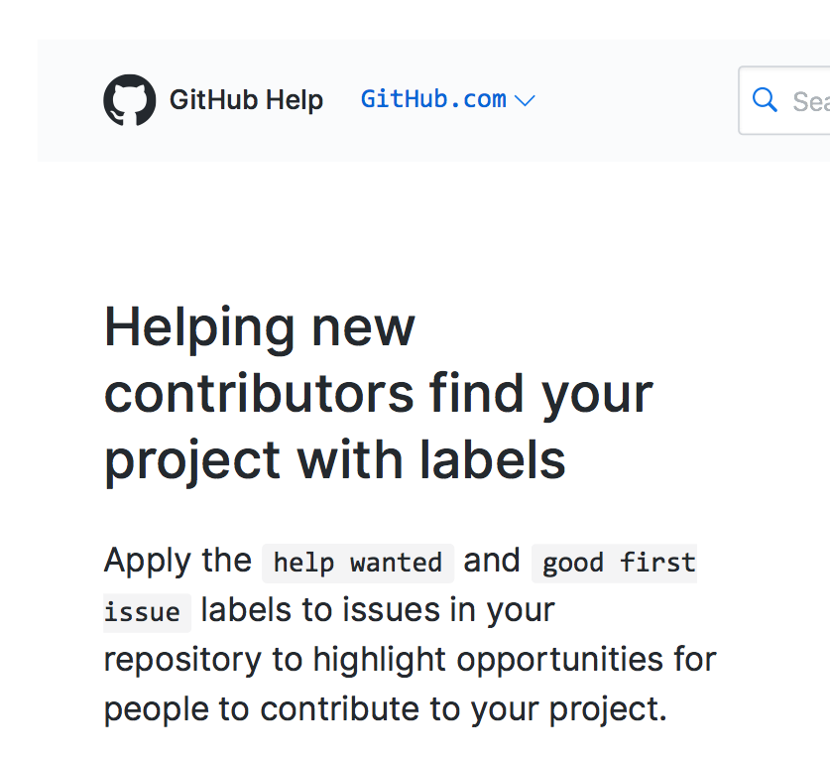
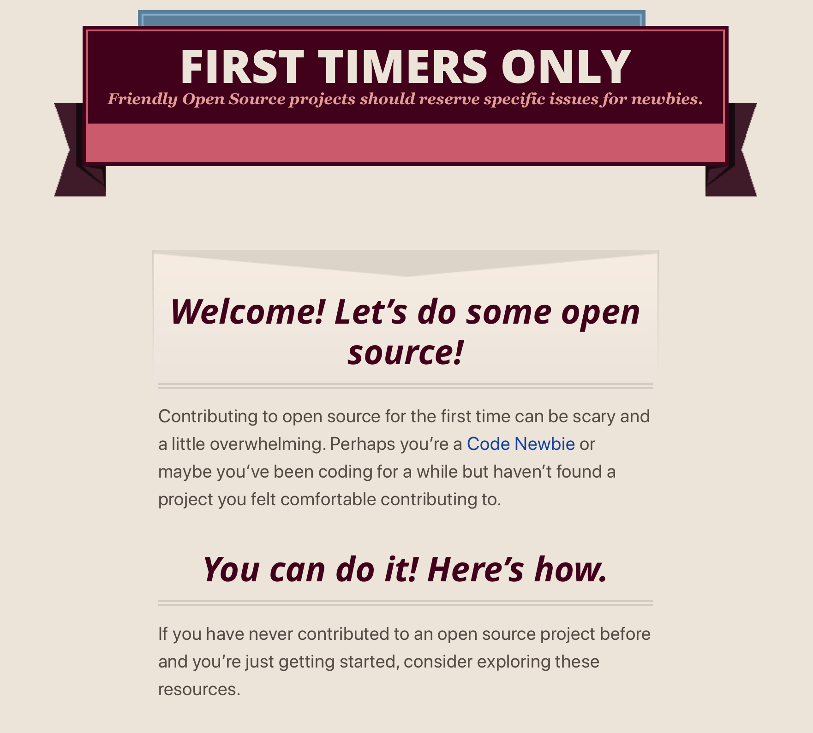
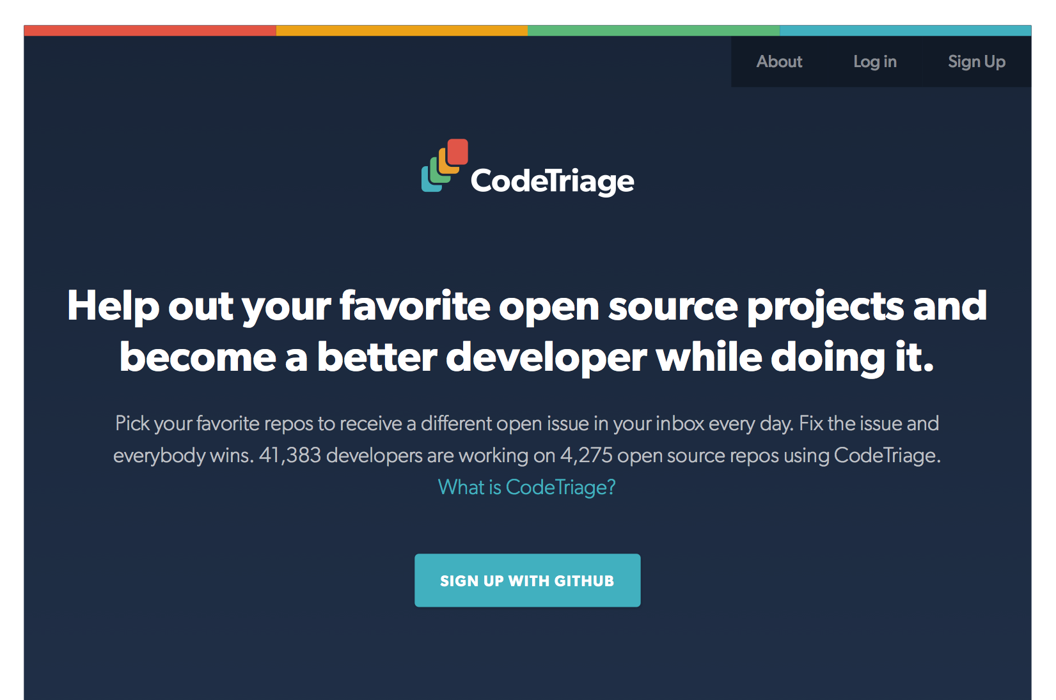
Recent trend: Guides for newcomers

Slide 42
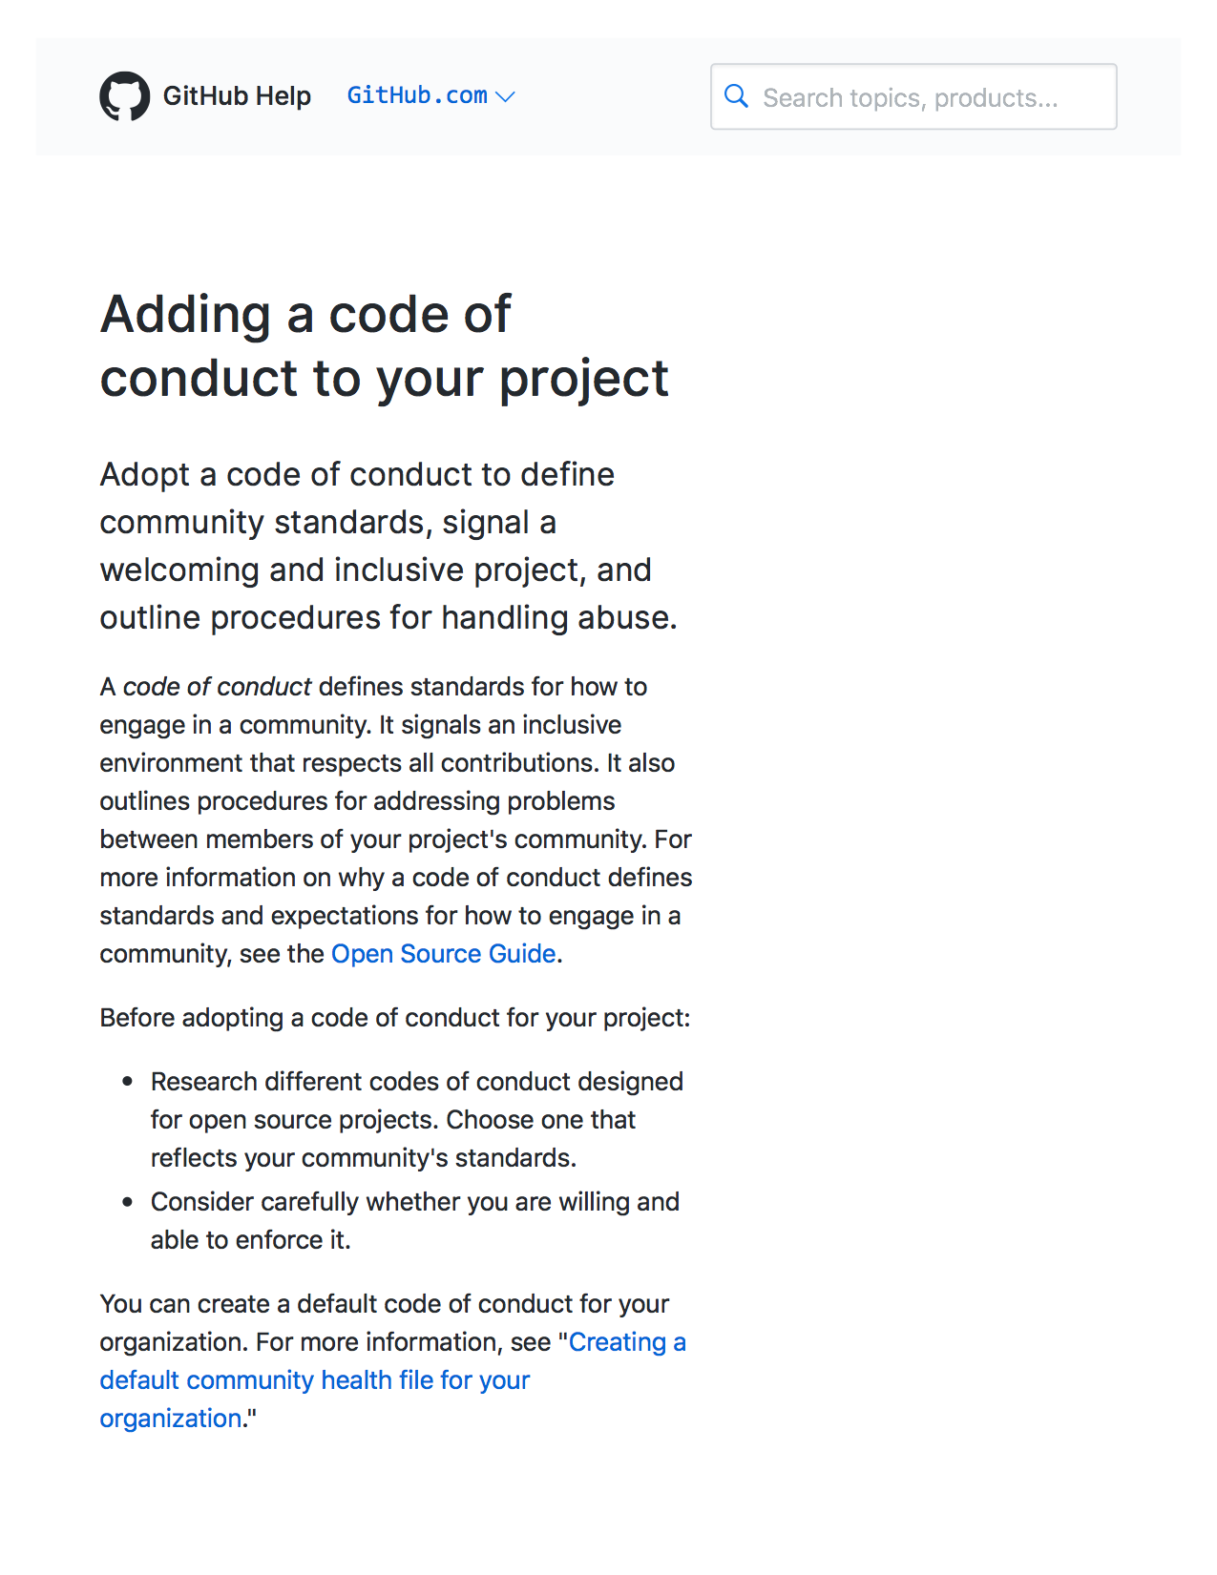
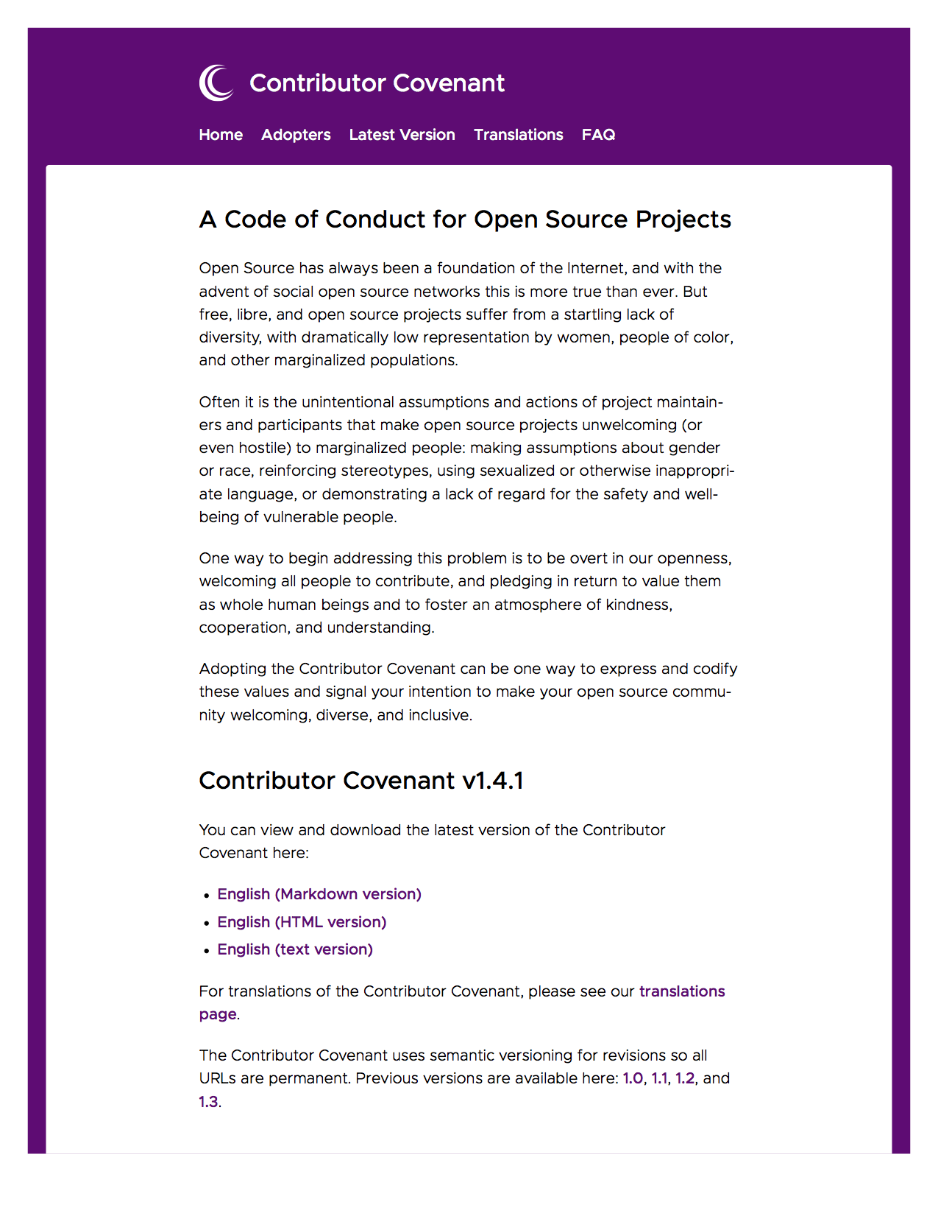
Recent trend: Codes of conduct
(Tourani, Adams, & Serebrenik, SANER 2017)

Slide 43
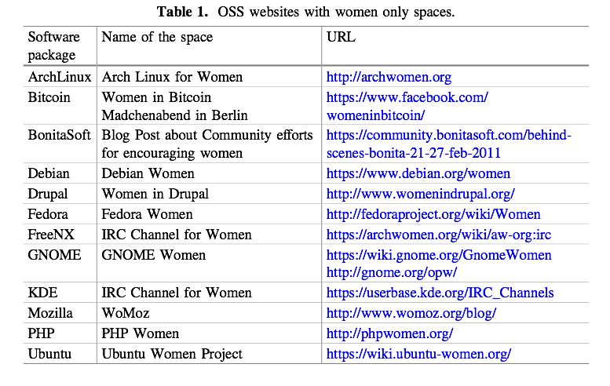
Recent trend: Safe spaces
(Singh & Brandon, OSS 2019)

Slide 44
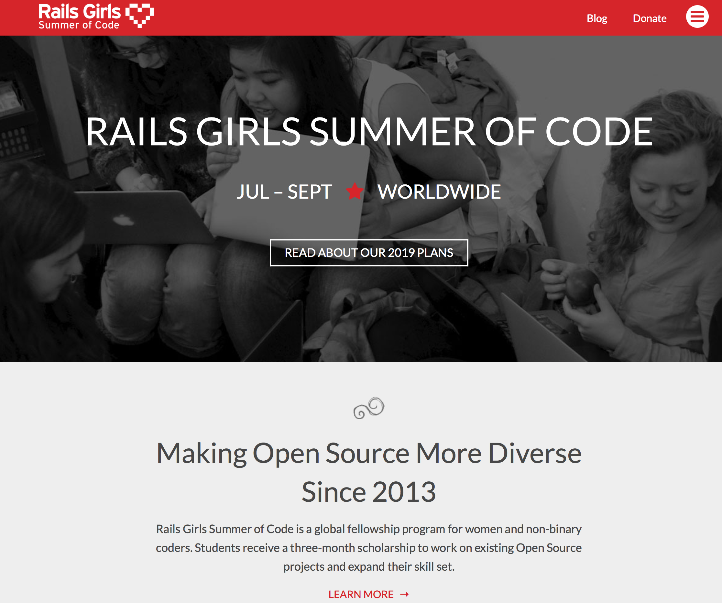


Recent trend: Summer of Code
2018: “11.63% of accepted students are women”
https://opensource.googleblog.com/2018/06/google-summer-of-code-2018-statistics-part-2.html

Slide 45

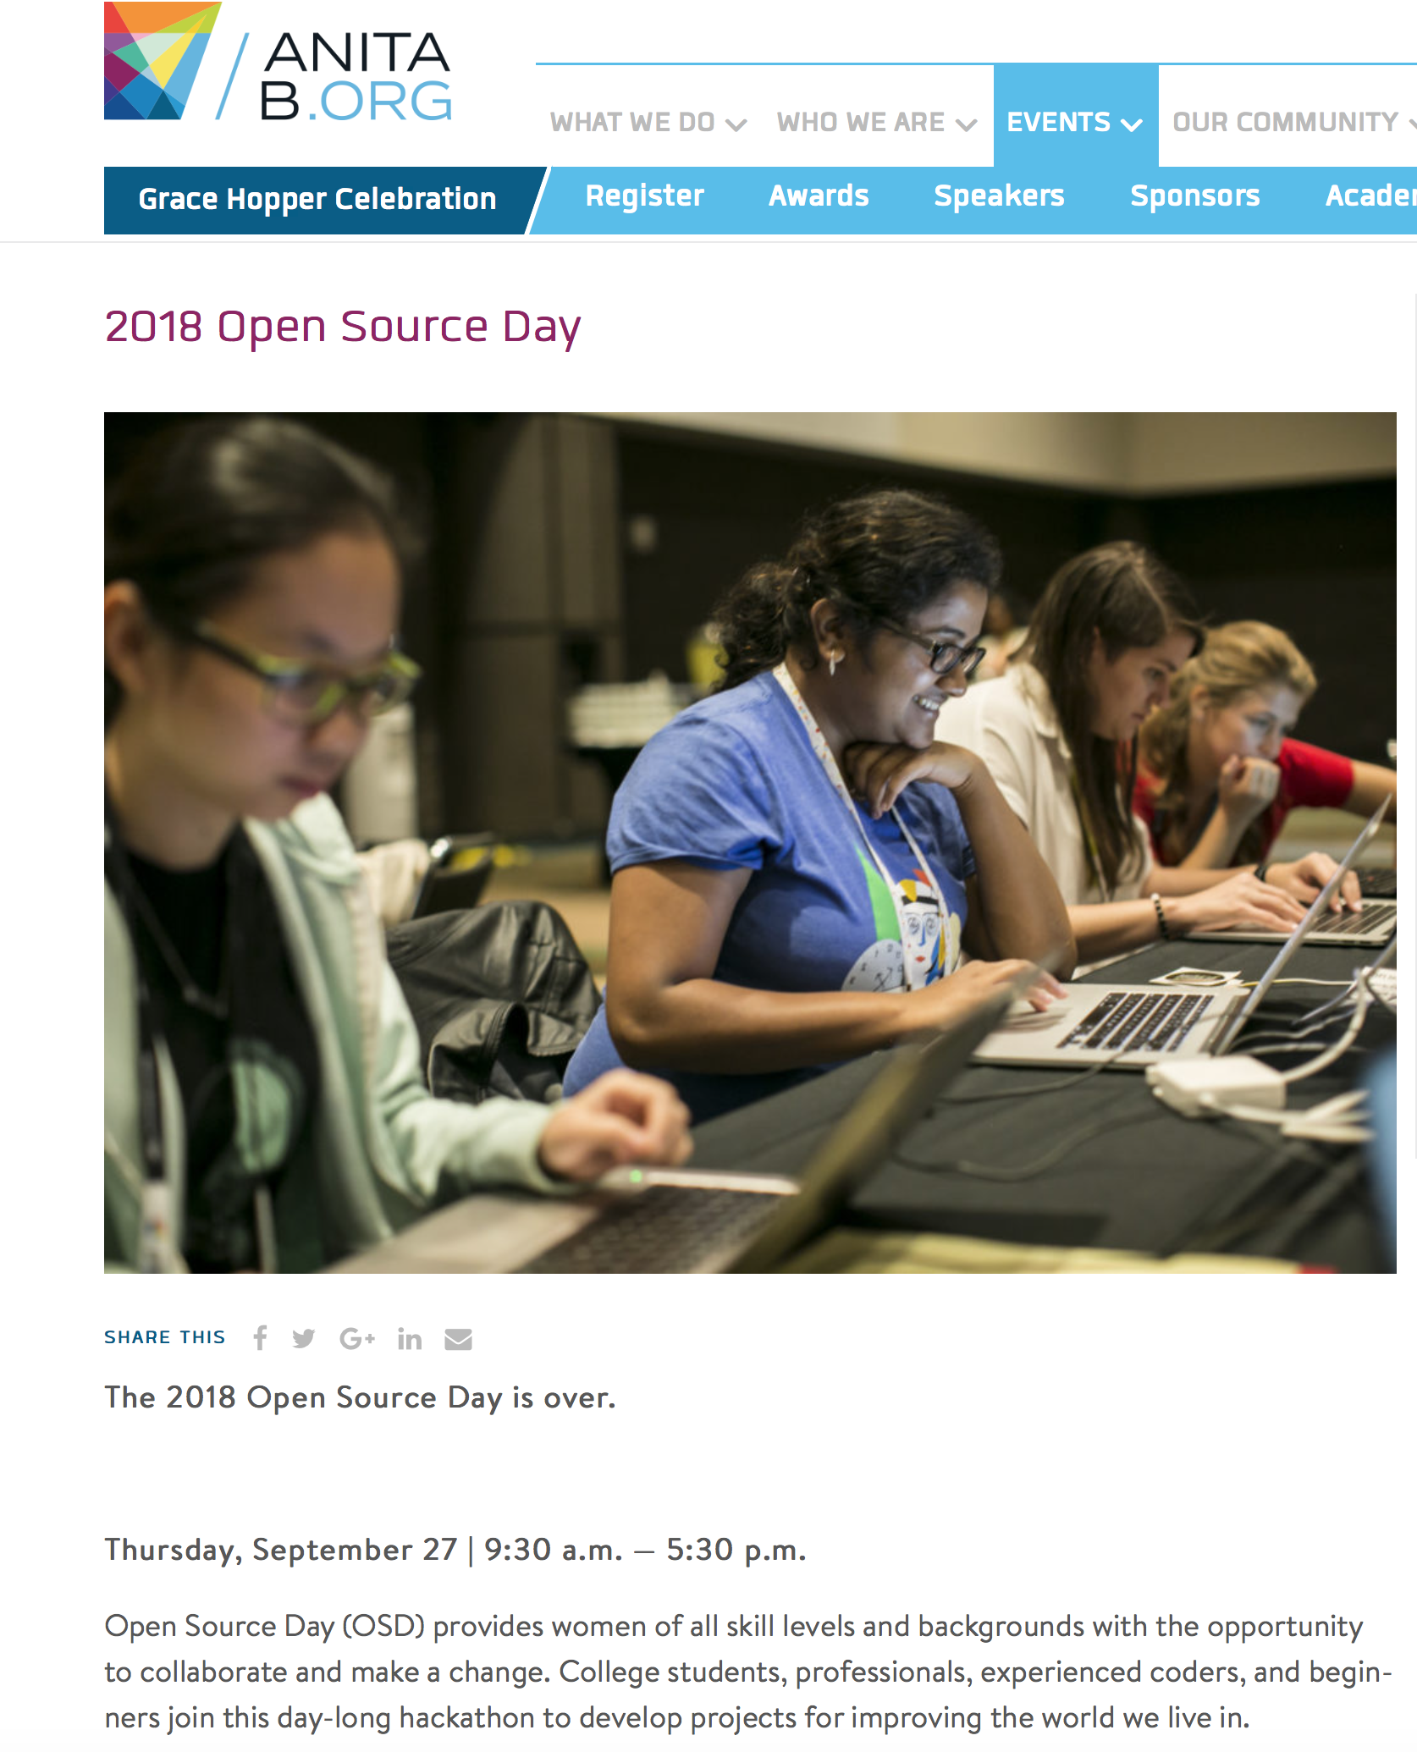
Recent trend: Hackathons

Slide 46
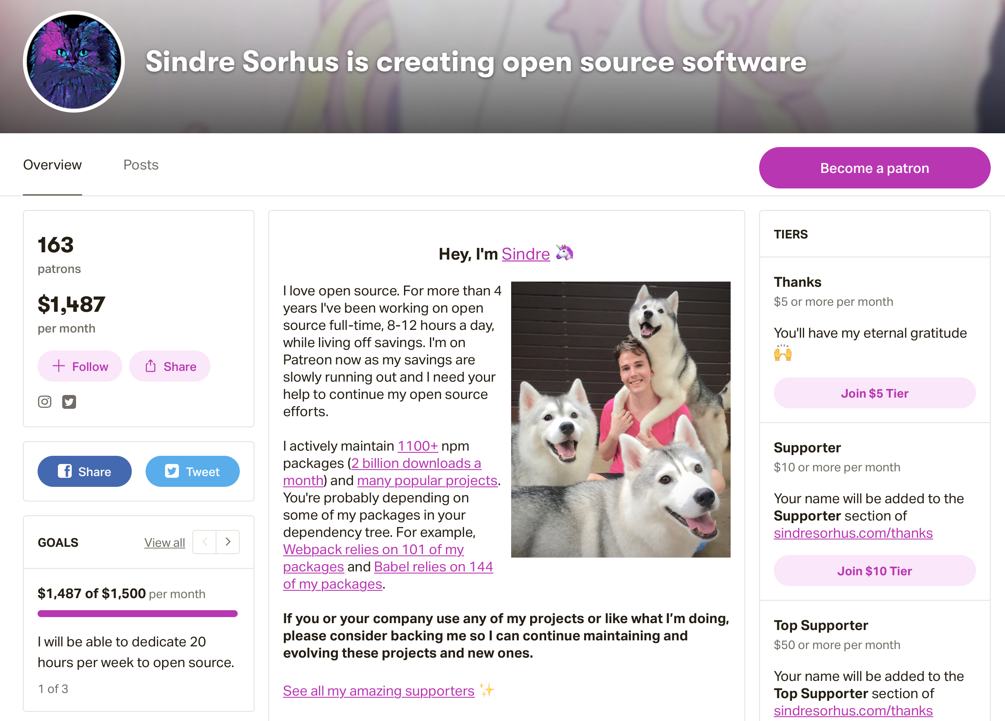
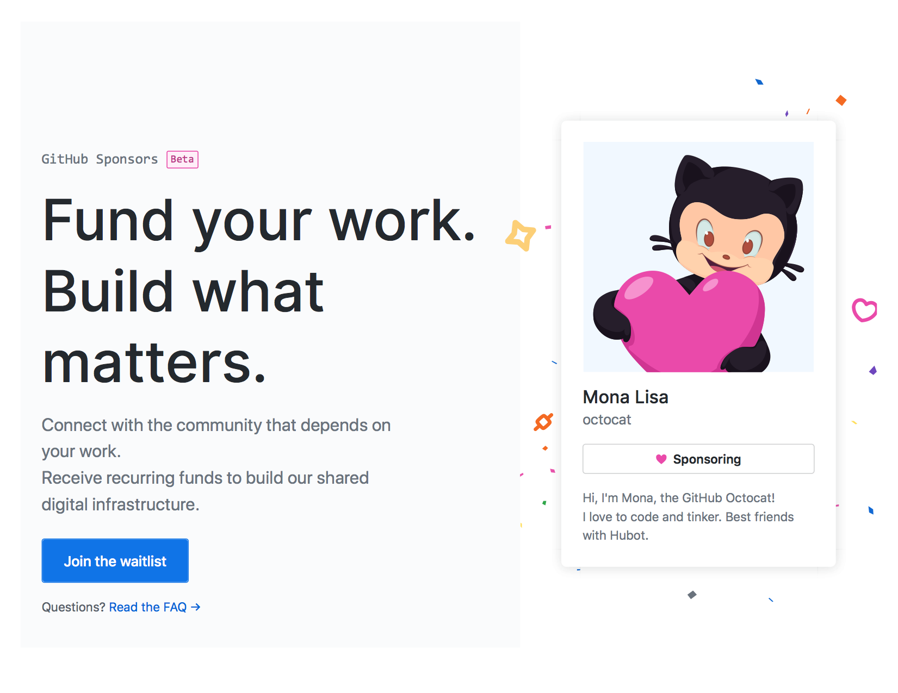
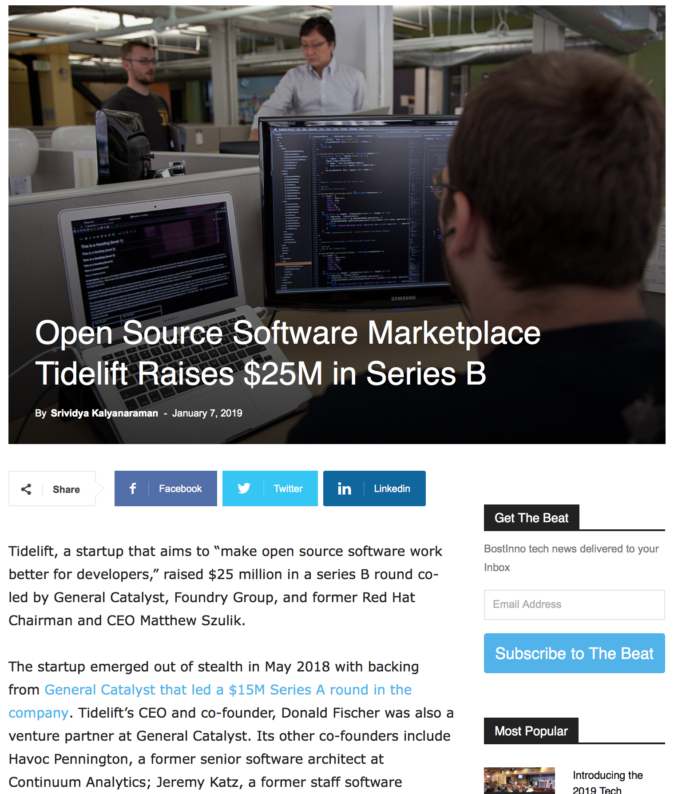
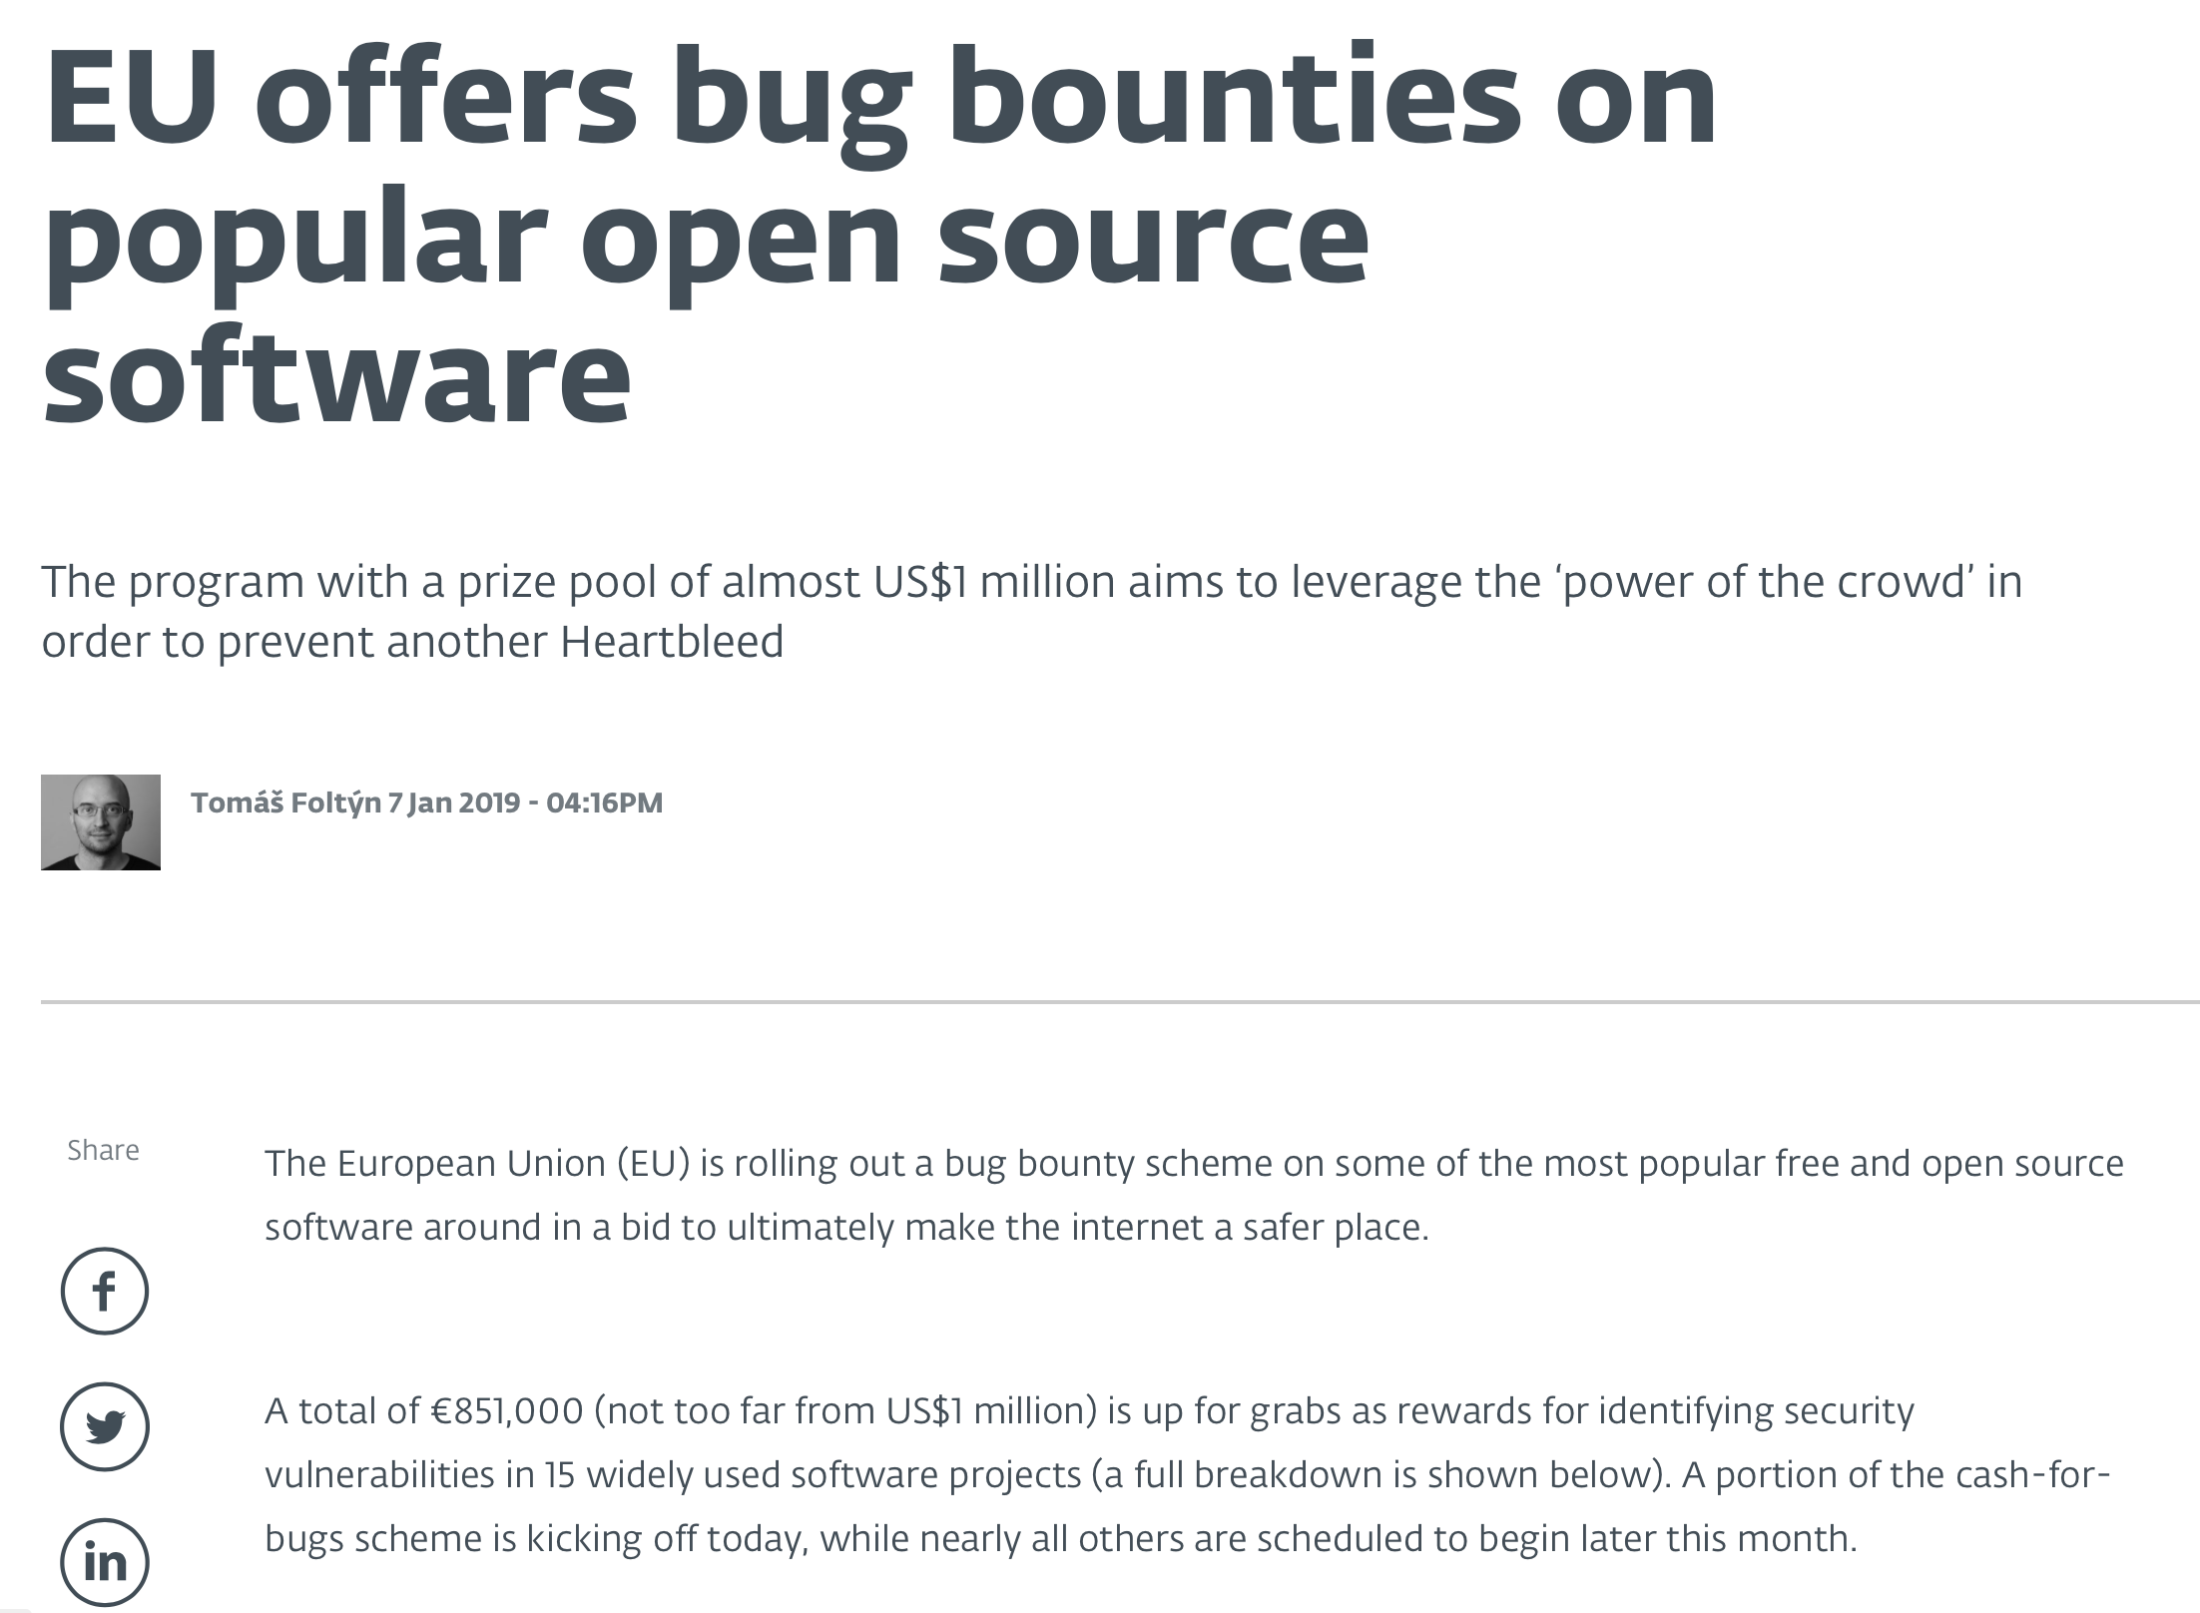
Recent trend: New forms of funding
https://github.com/sponsors
https://www.americaninno.com/boston/bostinno-bytes/open-source-software-marketplace-tidelift-raises-25m-in-series-b/
https://www.patreon.com/sindresorhus

Slide 47
What are people doing to attract & retain (diverse) contributors to open source?

Slide 48
Research Study: Building social capital
Why do women disengage earlier than men?
Going Farther Together: The Impact of Social Capital on Sustained Participation in Open Source. Qiu, H.S., Nolte, A., Brown, A., Serebrenik, A., and Vasilescu, B. ICSE 2019
Notes:
We look at history on these projects and apply statistics to reason about what happened and test cause and effect hypothesis
What Git is, version control history, etc.

Slide 49
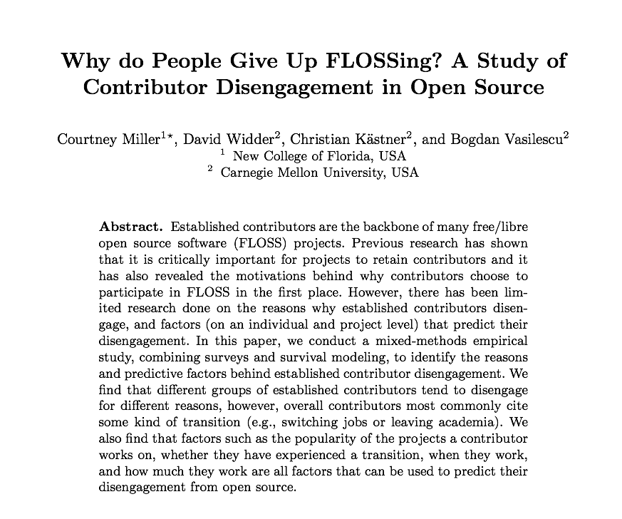

Building social capital
Why do women disengage earlier than men?
Part of the explanation comes from the developer survey in our paper
Reasons why people disengage:
Work-related (e.g., new job)
Personal* (e.g., different hobby)
*women cite more often than men
See also:
Going Farther Together: The Impact of Social Capital on Sustained Participation in Open Source. Qiu, H.S., Nolte, A., Brown, A., Serebrenik, A., and Vasilescu, B. ICSE 2019

Slide 50


Social capital theory explains long-term engagement
Bonding social capital:
benefiting from strongly connected network
Bridging social capital:
benefiting from network with diverse info
Willingness to continue
Opportunity to continue
(Coleman, 1990)
(Burt, 1998, 2001)
Notes:
To understand contributors’ sustained participation, we dug deep into the social science literature and found the social capital theory.
Social capital is the set of benefits that people can gain from their social connections.
There are two types of social capital from two types of connections.
(click) One is called the bonding social capital, introduced by Coleman.
Bonding social capital can be BUILT through strong social connections.
Networks with many strong connections can provide people a sense of belonging and therefore the willingness to continue.
In open source, we consider a project to be a network and contributors can form strong ties by contributing to the same project.
If many people within a project have worked together in the past, we expect that this project will provide stronger bonding social capital.
(click)
Another type of social capital is called bridging social capital, introduced by Burt.
One can build bridging social capital by connecting to different groups. It provides people the access to diverse information sources, thus giving people more opportunities to continue their participation.
In open source, we expect that being part of teams with more diverse information (for example, different technologies) should provide one with more opportunities to engage in new projects and continue their participation.
This informs our first hypothesis: being exposed to projects with high potential for building social capital, either bonding or bridging, associates with higher chance of prolonged engagement

Slide 51

Cohesive networks might foster discrimination / exclusion
Notes:
Moreover, social capital theory also states that, while networks with strong ties provide support and a sense of belonging, they can also foster discrimination. Groups of people who are tightly bonded to each other can form an echo chamber, where everyone’s ideas or bias can be magnified. This may put outsiders or minority groups at a disadvantage.

Slide 52





Being part of teams with more diverse information ~ more prolonged engagement, esp. for women
Information diversity should reduce the risk of demographic- based echo chambers.
Notes:
However, social capital theory might offer another explanation for the higher disengagement rate among women.
Following the theory, because they are in the minority, women may be more susceptible to biases from the male-dominated in-group.
However, we expect that the risk of exclusion should be lower for women when the teams are diverse wrt non-demographic attributes, such as information, because this should reduce the risk of echo chambers forming that amplify existing biases. This is our second hypothesis.

Slide 53







Large-scale mixed-methods study
Notes:
To test these two hypotheses, we designed a mixed-methods study.
(click) Using GHTorrent, we identified GitHub committers with full names and sampled 300,000.
(click) We then applied heuristics to merge aliases and infer gender, further compiling a balanced sample of around 60,000 users. We assumed binary gender in our study. We know this is a simplification, but we did it to make our analysis tractable.
(click) Next, we applied survival analysis and built a COX REGRESSION model to understand how social capital can explain people’s sustained participation on GitHub. This is a statistical modeling technique for time-to-event data. In our case the event is disengagement from GitHub, not making any commits for a whole year.
(click) For comparison and additional insights, we also surveyed a subset of these contributors about their building of social capital and reasons for disengagement. We used validated multiitem scales for social capital in the survey. In the interest of time, I won’t go over the survey details in this talk, but you can find them in our paper. All I will say now is that by and large, the survey confirmed the effects of social capital we observed from the survival analysis.
Next I will highlight some of our methods. Let me start from (click) our gender classifier. (click)
, then sampled three hundred thousands of users and ran our gender classifier to obtain their gender.
We found that around 10% of them were women, which is around 30,000. We then balance sampled the same number of men.
(click) For contributors who survived their first 3 months, we built a COX REGRESSION model to understand how social capital can explain their sustained participation on GitHub.
In addition to validated measures in the social capital literature, we also sent out surveys to a small subset of contributors to ask their perceived social capital, so as to triangulate our measures.
****ALEX******
I miss one of the main reasons for why we did the survey in the first place. We did it because we cannot be sure that people actually interact just because they contribute to the same repository and if they dont interact there is no chance for social capital to form.
****ALEX******
We built a logistic regression to analysis our survey result.

Slide 54





Inferring gender from names
Public name lists & celebrity names,
including 3,000 East Asian names
https://github.com/tue-mdse/genderComputer
https://www.namsor.com
Naive Bayes
classifier
Binary gender prediction
name features, e.g., the last two characters
Notes:
First, inferring gender.
There are many gender inference tools out there. Some use names, others use photos, others text. None of them is perfect.
After trying many, we decided to combine two well-performing name-based techniques into a higher-order classifier.
Our classifier also considers other name features and was optimized for romanized East Asian names, which most gender classifiers are not good at.
Please refer to our paper for more details. But I wanted to highlight that our classifier does better on Romanized East Asian names than the other two tools.
***********************************
We’ve tried many of them and used different data from users, such as their names, their profile pictures or the way they talk. Didn’t work due to insufficient data
We decided to use two of the more promising tools that infer gender from people’s names. On top of that, we added more data of romanized East Asian name, which most gender classifiers are not good at. We extracted name features such as the last letter, and built a NB.
TOO MUCH ALL AT ONCE. MORE ANIMATION. First: genderComputer, namsor. Then more features
SPEND LESS TIME ON THIS
NEED TO SAY THIS IS ALSO A CONTRIBUTION

Slide 55






Bonding social capital – Team Familiarity
TIME
Project A
Project C
Project B
Project X
End of data
(de Vaan et al., 2011, Lutter 2015)
Notes:
Next, to measure bonding social capital, which is about cohesion, we need to measure how often have contributors worked together in the past.
We split the overall GitHub data into 3-month windows and kept track of which people in our sample worked on which project during which three-month window. This is the data we use for the survival analysis.
We used validated measures from de Vaan and Lutter.
The first measure of bonding social capital is (click) the team familiarity, which captures pairs of contributors who have (click) worked together in other projects.
In other words, team familiarity is tracing the number of dyads among contributors.
who studied social capital in game industry and film industry, both are also dynamic project based

Slide 56

Bonding social capital – Recurring Cohesion
TIME
Project C
Project D
Project X
End of data
(de Vaan et al., 2011, Lutter 2015)
Notes:
Similarly we measure a team’s recurring cohesion, meaning how many cliques of 3 (click) or more people (click) have worked together in the past.
The more cliques, the more cohesive the team and therefore the more opportunities to build bonding social capital.

Slide 57
Bridging social capital – Language Diversity
TIME
C++
Java
C
Project X
C++
C
End of data
(de Vaan et al., 2011, Lutter 2015)
Notes:
To measure a team’s information diversity, which should lead to more bridging social capital (our first hypothesis) as well as reduce the disengagement risk for women (our second hypothesis), we compute two measures:
The team’s programming language diversity: how different are the backgrounds of the different contributors on average (click), based on what projects (click) they worked on in the past

Slide 58
Bridging social capital – Share of Newcomers
TIME
Project X
Project X
Project X
End of data
(de Vaan et al., 2011, Lutter 2015)
Notes:
And the team’s average share of newcomers: how open the project is to new contributors (click). The intuition is that newcomers may bring in new information sources.
You can find all the details in the paper.

Slide 59

COX regression model
Contributor | Time | Active | Social capital | Control variables
 | 2008 Jan – Mar | True | Team familiarity Recurring cohesion Language diversity Share of newcomers | Project size Project owner ……
 | 2008 Jan – Mar | True | Team familiarity Recurring cohesion Language diversity Share of newcomers | Project size Project owner ……
 | 2009 Apr – Jun | False | Team familiarity Recurring cohesion Language diversity Share of newcomers | Project Size Not project owner ……
active, major contributor, proj owner, social capital
active, major contributor, not owner, social capital
active, minor contributor, not owner, social capital
left, minor contributor, not owner, social capital
Notes:
Each data row aggregates the different measures for a contributor within a 3-month window (click), across all their projects that window.
The response / dependent variable (click) is a Boolean capturing whether the contributor is still active or has disengaged.
We include the different measures of social capital (click) I just described, and also control for the obvious confounds (click), such as project size, or whether the contributor was the project’s owner.
This is the data that was fed into our COX regression model.
It is worth noting that the COX model is a multivariate regression model, which can tell us for any variable how it associates with the risk of disengagement, while holding all other variables fixed.

Slide 60

More social capital ~ more prolonged engagement
Notes:
So now let me describe our main results.
Our first hypothesis was that higher social capital correlates with more prolonged engagement.
We found strong support for H1 in the survival analysis.
All the social capital measures, both bonding and bridging, associate positively with prolonged engagement.
For example, this plot illustrates the effect of the recurring cohesion variable, which captures bonding social capital.
I’ve plotted two curves for high and low cohesion corresponding to the top and bottom quartile.
After 2 years, people in teams with high cohesion are 7% less likely to disengage than those in teams with low cohesion, holding the other variables constant.
This is exactly what social capital theory predicts. Higher bonding social capital leads to a higher sense of belonging and therefore more willingness to continue.
You can find more examples in the paper.
which states that people with higher bonding social capital have a sense of belonging and therefore have willingness to continue.
We found evidence supporting the first hypotheses, which is that higher social capital associates with prolonged engagement.
Both measures of bonding social capital, team familiarity and recurring cohesion, are associated with prolonged engagement.
This plot includes contributors who disengaged after their first 3 months on GitHub.
The intuition behind the COX regression model is that, holding all other variables static, the coefficient of a variable tells us how it contributes to the time to the event, which is early disengagement in our case.
For example, the coefficient on gender tells us the risk of an average woman disengaging vs an average man disengaging, when holding all other variables constant.

Slide 61

Women in language- (informationally-) diverse teams disengage at lower rates
Notes:
Our second hypothesis was that being part of teams with higher diversity of information correlates with more prolonged engagement, especially for women.
In the survival analysis, we found a significant interaction effect between team programming language diversity and gender, which supports this hypothesis.
This plot illustrates the interaction effect. The blue curve shows the difference in survival probability between women in teams with high language diversity (above median) and women in teams with low language diversity (below median). Similarly the yellow curve for men.
First, note how both curves are always positive. Remember, programming language diversity was one of the social capital measures from the previous hypothesis that correlates with prolonged engagement. So the high language diversity groups have higher probability of long-term survival than the low language diversity groups, hence the positive curves for both men and women.
Second, and more interestingly, note how the female curve is practically never lower than the male curve. Meaning that women benefit more than men from higher information diversity, which can help build bridging social capital. However, note how the effect only manifests itself later in one’s tenure: (click) early in their tenure women and men benefit just as much from higher information diversity; (click) the gap becomes noticeable later on.
This is probably because one doesn’t immediately need to find new opportunities for engagement with new projects after starting to contribute to a particular project. The need only comes later. And for women in particular, these potential new opportunities for engagement counteract the other disengagement risk factors more than for men.

Slide 62





Implications
Recommend projects that can help build social capital
Find relevant mentorship
Signal social capital moderators
Notes:
So what does all of this mean and what can we as a community do next?
For example, we envision search or project recommendation engines on platforms like GitHub, that try to maximize the potential for building social capital. These could be based on measures of team familiarity, recurring cohesion, or information diversity similar to the ones in our study, which we showed correlate with lower risk of disengagement long-term.
There is also an opportunity to improve the mentorship process for both new and established contributors, pairing mentees with mentors that could help increase the mentees’ social capital.
Finally, we envision user interface elements such as repository badges, that allow project maintainers to track worrisome trends in factors negatively associated with the development of social capital (e.g., team expertise diversity and turnover).
SPELL OUT WORDS
SLOW DOWN

Slide 63
Questions, comments, discussion?
<Break until 10:45AM>

Slide 64
Friday morning
Session 1
Tools and data

Slide 65
During this session you will
Learn about our previous work on what influences contribution to projects
Brainstorm features that could influence diversity
Load data into Python
Perform basic calculations on the data (data aggregation)

Slide 66
Signals contributors look for when choosing open source projects

Slide 67
Interview protocol
○Pre-select 5 npm projects
○Create a persona: Jane is a recent college graduate who is now a junior software engineer. She has experience in JavaScript but hasn’t done any open source contributions.
○Ask participants to evaluate 5 projects and advise Jane whether or not each of them is worth her contribution.

Slide 68

Projects’ features

Slide 69
“README
is a project’s welcome mat”
Structure
Project description
Contact information
Code quality badges
Logo
Structure: there is an “unofficially agreed template of a project,” and maintainers should “follow what everyone else is doing” (P7).
Project description: “The README is most important. It should describe without having to navigate away from that page the key information people need ” (P14).

Slide 70
Contributing file
“suggests they have some experience with handling
new contributors ”
Prominent
Thorough
Different ways to contribute
Prominent: It is desired to have a link to the CONTRIBUTING.md or a contributing section in the README.
Thorough: “It says ‘please ask first’ because otherwise people might feel that the pull requests always have to be merged in ” (P14).
Explain GitHub jargons: “A lot of new people who don’t know GitHub don’t necessarily know what the issue tracker was” (P14).

Slide 71
Activity
Recent commits and contributors: Recency of activity signals that “the project is not dead” (P5).
Evenly distributed: “if only one or two people are the core contributors, then it would be dangerous; [the project may be left unmaintained] ” (P6).
“I want to know why these PRs are not merged. I wouldn’t want to waste the effort put in to understand their code base or write code” (P11)
“[An] active project [should have] some conversation happening, and generally it has been positive and ideally with reasonably quick responses.” (P14).

Slide 72
Inclusiveness
“Look at the language throughout to feel whether it’s inclusive or it feels maybe a bit of a boy’s club or sort of aggressive, or intimidating for beginners; all these things would make me stay away” (P15).
“If I saw a project where it seems like a mix of genders, I would definitely feel more excited about the project” (P15).

Slide 73
Brainstorm:
How can we measure these features?
README:
thoroughness
structure
Contributing guideline:
thoroughness
prominence
Activity level
number of recent contributors
distribution of commits
comments in issues/pull requests
Inclusiveness
gender ratio
language inclusiveness

Slide 74
README:
number of headers
Contributing guideline:
presence
Activity level:
recent commits
average response time to issues
Inclusiveness:
comment impoliteness
Popularity:
number of stars
README:
thoroughness
structure
Contributing guideline:
thoroughness
prominence
Activity level
number of recent contributors
distribution of commits
comments in issues/pull requests
Inclusiveness
gender ratio
language inclusiveness

Slide 75
Explanatory variables:
Number of headers in README
Presence of contributing guideline
Recent commits
Average response time to issues
Comment impoliteness
Number of stars
Control variables:
Project’s age
Number of issues
Had external committers

Slide 76
Explanatory variables:
Number of headers in README
Presence of contributing guideline
Recent commits
Average response time to issues
Comment impoliteness
Number of stars
Control variables:
Project’s age
Number of issues
Had external committers
Measurement:
From Jan 1, 2018
To Jun 30, 2018
Outcome variable:
Between July 1 to Sep 30, 2018
Whether there was new contributors join the project
Whether there was new GitHub user join the project
Analysis:
Logistic regression (session 5)
How can each variable help predict the outcome variable

Slide 77
Logistic regression results
Outcome: new contributors to the project
- Project’s age
+ Number of issues
+ Had external committers
+ Number of headers in README
- Presence of contributing guideline
+ Recent commits
+ Average response time to issues
- Comment impoliteness
+ Number of stars
Outcome: new GitHub users to the project
- Project’s age
+ Number of issues
+ Had external committers
Number of headers in README
- Presence of contributing guideline
Recent commits
+ Average response time to issues
comment politeness
+ Number of stars

Slide 78
Our analysis this weekend
Size (number of unique people, recent activity level) [Friday morning]
Readme measures (readability, headers) [Friday afternoon]
Issue comment measures (politeness, sentiment analysis, toxicity) [Saturday morning]
Data analysis (model building) [Saturday afternoon]

Slide 79
Install Python and Pandas
Install Python
https://realpython.com/installing-python/
Install Pandas
https://pandas.pydata.org/pandas-docs/stable/install.html
Open or install textEditor
Open your favorite text editor OR Install sublime (Sublimetext.com)
Notes:
Mac people: Open a terminal (Pip and install)

Slide 80
Walk through loading data into Python and running computations on it (with Sophie)
Notes:
Sum of a column, select

Slide 81
Getting the data
Download from Google drive
Check your email for the link….

Slide 82
Data overview
200 projects, one file per project, 41133 commits
Row is one commit, comma separated columns
Legend at the top with variables names
Gender: Male = -1, Female = +1
Sophie will walk us through the file and variables within:
window, committer_email, committer_name, sha, author_name, author_email, project_name, gender, uid, login, pid

Slide 83
Goal by the end of the next two sessions
Create a new csv file with:
One row per repo / project
Columns for features of the project that could influence gender distribution
Column for presence of women (0/1) - at least one row in the raw data is a commit by a woman
[Stretch goal] do distribution - resolve unique contributors, look at proportion women
Fri afternoon session - Readmes
Sat morning session - Issue comments

Slide 84
Friday afternoon
Session 2
Computing project features

Slide 85
Goal by the end of the next two sessions
Create a new csv file with:
One row per repo / project
Columns for features of the project that could influence gender distribution
Column for presence of women (0/1) - at least one row in the raw data is a commit by a woman
[Stretch goal] do distribution - resolve unique contributors, look at proportion women
This session - Focus on Readmes
Tomorrow morning - Focus on Issues

Slide 86
Getting more data!
Readmes for the project
Issue comments
Download from Google drive

Slide 87
Readme Features
Headers
Readability

Slide 88
Saturday morning
Session 4
Computing features and combining data
Notes:
At the same time there is extensive evidence for value in diversity, showing gender and racial diversity are associated with greater creativity and performance in teams, greater earnings (sales, revenue, profit) in organizations, and higher productivity in open-source projects. Enhancing diversity of open-source software projects should enhance their performance as well, improving their efficiency and the reliability and innovativeness of the code they produce.
~30% of employees at large tech firms (2016) 18% of computer science degree grantees in the US (2015) <6% of contributors with 10+ commits to public projects on GitHub
http://superuser.openstack.org/wp-content/uploads/2017/07/OpenStack-Gender-Diversity-Report_Apr2017.pdf

Slide 89
Goal by the end of this session
Create a new csv file with:
One row per repo / project
Columns for features of the project that could influence gender distribution
Column for presence of women (0/1) - at least one row in the raw data is a commit by a woman
[Stretch goal] do distribution - resolve unique contributors, look at proportion women

Slide 90
Finishing Readme Features
Challenges
How to clean up the text?
Remove code chunks?

Slide 91
Issue Comment Features
Politeness
Convokit.cornell.edu
Sentiment analysis
github.com/collab-uniba/Senti4SD
Toxicity
perspectiveapi.com/#/home

Slide 92
Saturday afternoon
Session 5
Data analysis & R
Notes:
At the same time there is extensive evidence for value in diversity, showing gender and racial diversity are associated with greater creativity and performance in teams, greater earnings (sales, revenue, profit) in organizations, and higher productivity in open-source projects. Enhancing diversity of open-source software projects should enhance their performance as well, improving their efficiency and the reliability and innovativeness of the code they produce.
~30% of employees at large tech firms (2016) 18% of computer science degree grantees in the US (2015) <6% of contributors with 10+ commits to public projects on GitHub
http://superuser.openstack.org/wp-content/uploads/2017/07/OpenStack-Gender-Diversity-Report_Apr2017.pdf

Slide 93
By the end of this session you will
Install R studio
Run basic descriptive stats on the data
Run a model

Slide 94
Installing R
R Studio

Slide 95
Data exploration: Plot histograms

Slide 96
Regression 101 & Logistic regression

Slide 97
Collinearity checks

Slide 98
Running your analysis

Slide 99
Sunday morning
Session 6
Polish analysis results
Notes:
At the same time there is extensive evidence for value in diversity, showing gender and racial diversity are associated with greater creativity and performance in teams, greater earnings (sales, revenue, profit) in organizations, and higher productivity in open-source projects. Enhancing diversity of open-source software projects should enhance their performance as well, improving their efficiency and the reliability and innovativeness of the code they produce.
~30% of employees at large tech firms (2016) 18% of computer science degree grantees in the US (2015) <6% of contributors with 10+ commits to public projects on GitHub
http://superuser.openstack.org/wp-content/uploads/2017/07/OpenStack-Gender-Diversity-Report_Apr2017.pdf

Slide 100
Model output: Interpreting the results

Slide 101
Sunday morning
Session 7
Work on presentation
Notes:
At the same time there is extensive evidence for value in diversity, showing gender and racial diversity are associated with greater creativity and performance in teams, greater earnings (sales, revenue, profit) in organizations, and higher productivity in open-source projects. Enhancing diversity of open-source software projects should enhance their performance as well, improving their efficiency and the reliability and innovativeness of the code they produce.
~30% of employees at large tech firms (2016) 18% of computer science degree grantees in the US (2015) <6% of contributors with 10+ commits to public projects on GitHub
http://superuser.openstack.org/wp-content/uploads/2017/07/OpenStack-Gender-Diversity-Report_Apr2017.pdf

Slide 102
Making your slides: Sections to include
Motivation
Highlights of your results
Method
Results
Conclusion
Summary slide

Slide 103
Designing your slides

Slide 104
First create an outline, then make slides
List down the main ideas.
Turn each idea into its own slide.
Keep each slide (relatively) sparse.
Transition between slides with verbal cues.

Slide 105

Try using the “assertion-evidence” model
Slide credit: Kayvon Fatahalian's talk
Title asserts the main point
Use visuals as much as possible to simplify the idea (evidence)

Slide 106

Don’t include slides that don’t add much value
For a short talk, having an outline like this gives no information to the audience.
Use section slides if necessary.

Slide 107

Use the last slide effectively
What should the audience takeaway ?
Remember this slide will stay on a little longer.

Slide 108

What do you think of this slide ?

Slide 109
What do you think of this slide ?
Why are these interesting?
Don’t just dump citations.
Could you use visuals instead ?

Slide 110

Example slide : Good or Bad ?

Slide 111

Example slide : Good or Bad ?

Slide 112
Slides must be easy to read for all in the room
Contrasting text and background colors
Font size >20 pt, Sans-serif fonts
More simple slides is better than a few cluttered ones
( <= 1 minute per slide)
Proofread!

Slide 113
Usage rights and citations
Remember usage rights
Do not copy material (images, videos, clipart) without checking their usage rights
Always credit authors when using their content
Remember citations!
textbook has info on styles

Slide 114
Presenting your slides

Slide 115
Practice
Practice until partner cues are down and you know the material
Don’t read from/memorize a script (but do make a script)
Speak a little slower than you think you need to
Be engaging. If you’re not enthusiastic, why should we be?

Slide 116
Other tips
Record yourself and replay (annoying but useful, recognize your filler words “..like”, “..so”, “..however” too many times)
Listen to what you say and watch your slide (are you getting ahead of the slide, do you need another slide ?)
Do you know what slide is coming next ? If you are repeatedly getting confused the order might need reworking)
Do you wish to refer to an earlier or later slide as you speak ? Use some form of signposts.

Slide 117
More resources
CMU GCC handout
How to give a great research talk
Presenting: structure story and support
Kayvon Fatahalian's talk
Examples of good slide design
https://cmustrudel.github.io/slides/icse19social.pdf (paper PDF)
https://cmustrudel.github.io/slides/icse18badges.pdf (paper PDF)

Slide 118
Bogdan’s Presentation Tips
https://drive.google.com/file/d/1f2iscUS5NaeiMMTp68PIkE3vm_1FeMBM/view

